Slide 1
Insurance Requirements in Contracts
Fitting the Pieces Together Conference
April 18, 2025

Slide 2
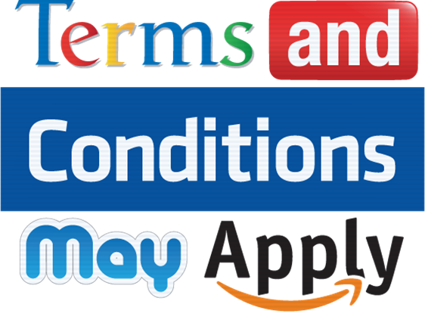
Caveat
Consult with Legal/Risk Management before changing contract language.

Slide 3
How to Locate and Navigate the IRIC Manual

Slide 4
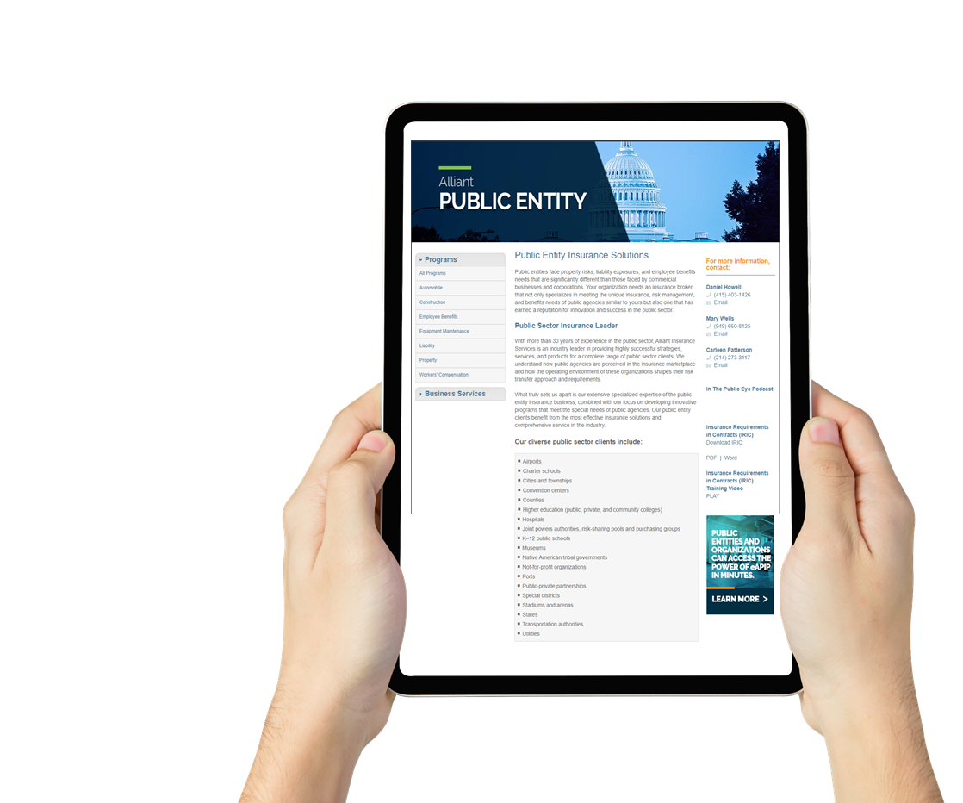
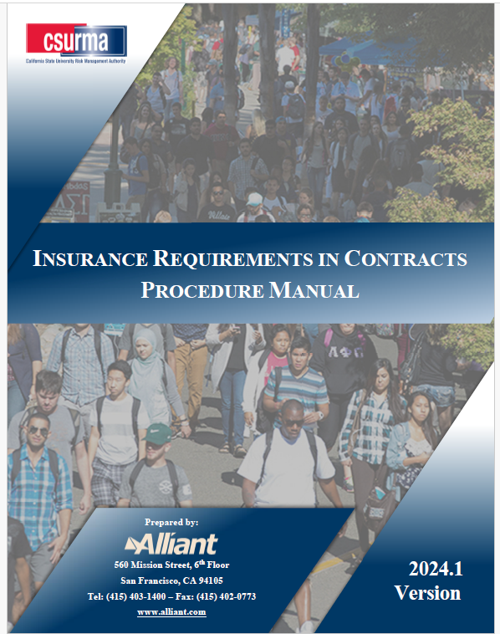
How to Locate the IRIC Manual?
Insurance Requirements in Contracts (IRIC)
Download IRIC:
PDF | Word

Slide 5
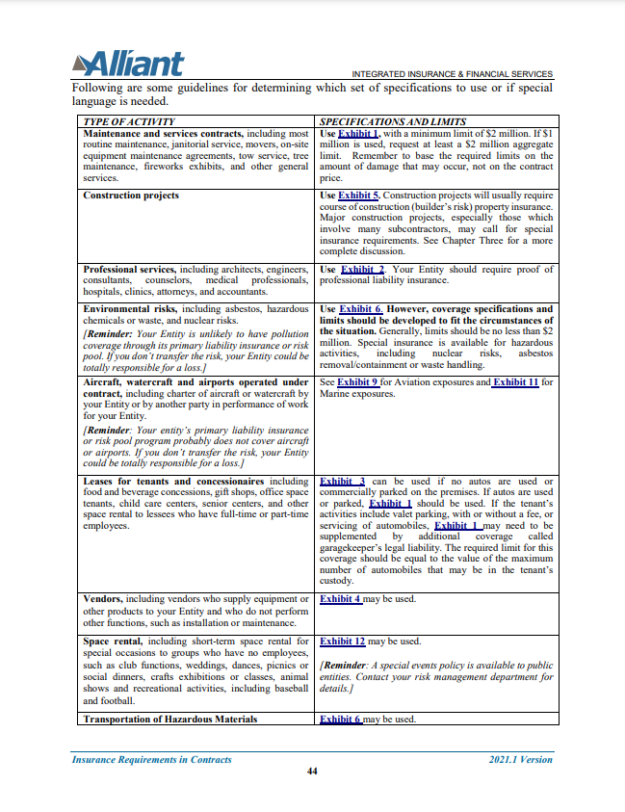
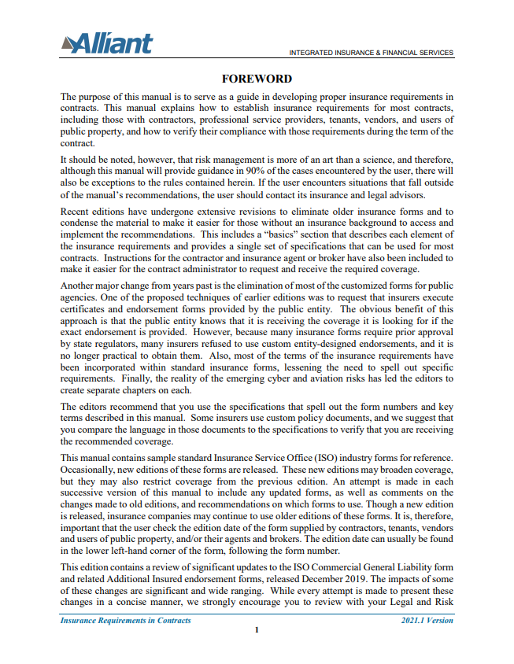
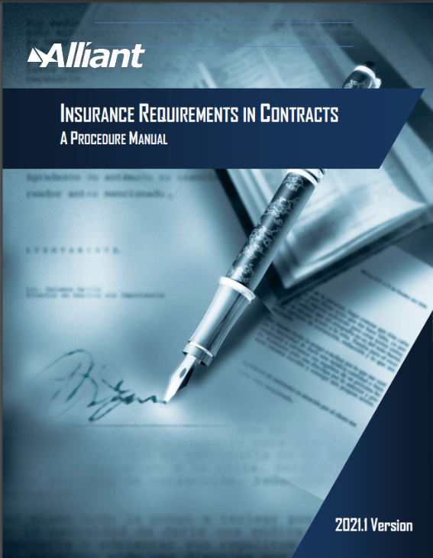

Navigating the IRIC Manual

Slide 6
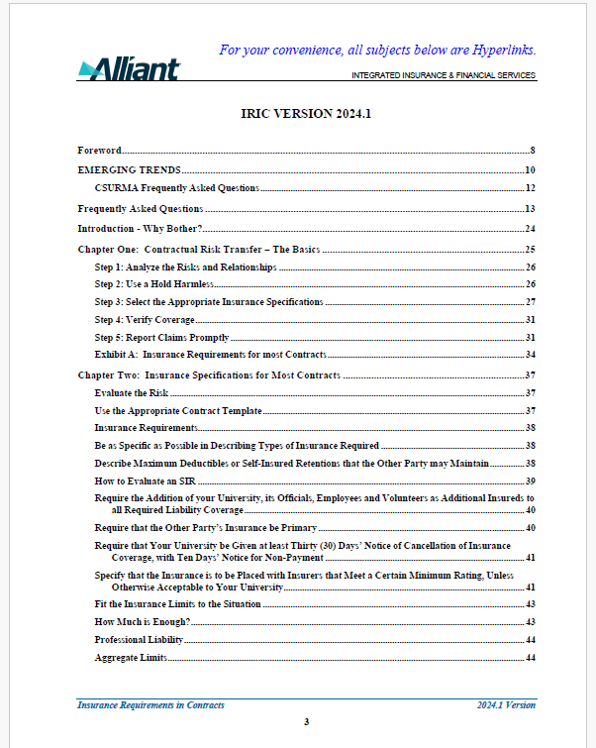

Table of Contents
Links to Pages
Love Those FAQ’s!
Ctrl + Click to follow link

Slide 7

Nine Chapters and Fourteen Exhibits
Insurance Specs For:
Most Contracts – Exhibit 1
Professional Services
Lessees
Suppliers and/or Vendors
Construction Contracts
Environmental Contractors & Consultants
Information Technology - Cyber
Airports
Unmanned Aerial Vehicles (aka Drones)
Chartering Aircraft
Marine Related Risks
Short-term Rentals of Facilities
Instructors
Schools including Bus & Transportation Costs

Slide 8
The Risk Management Process

Slide 9

The Risk Management Process
  Evaluate the Risk
  Who could be harmed? Visitors attracted?
  What are the activities and maximum likely loss? Dangerous? Crowds? Pollution? Alcohol?
  Where? On vs. off Entity premises? Site control?
  When? Night? During sporting events?
  How likely would the Entity be a defendant if there is a loss?
Notes:
ZG

Slide 10
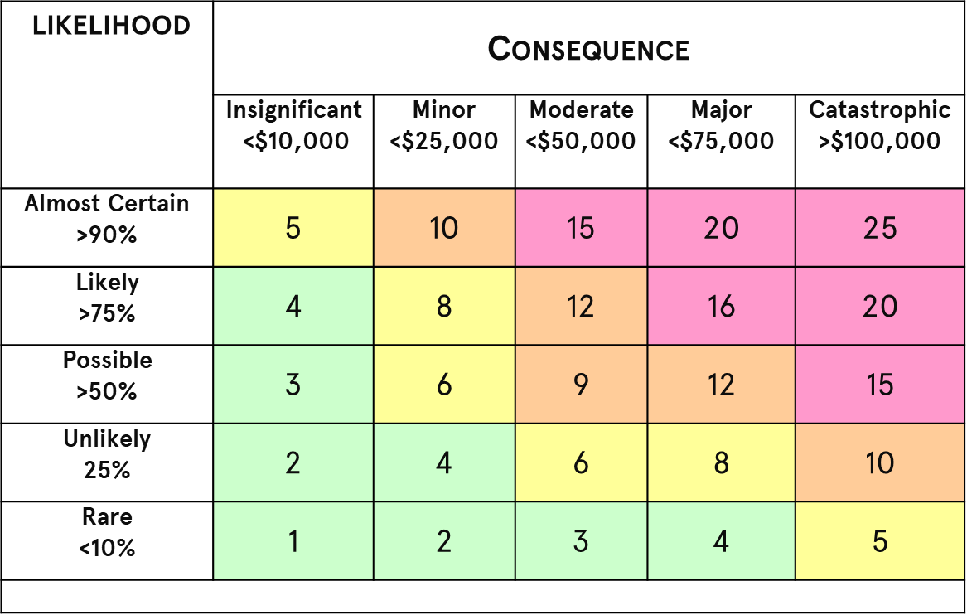
The Risk Management Process
Evaluation Matrix
How likely is this to happen?
How severe are the consequences?

Slide 11
The Risk Management Process
Consider the Best Technique
Identify exposures
Analyze exposures
Consider feasibility of alternative techniques
  Prevention/reduction
  Retention
  Avoidance
  Transfer
Select the best technique
Implement technique
Monitor results and change as needed

Slide 12
The Risk Management Process
How Much Coverage is Enough?
The U.S. tort system amounted to $443 billion in 2020, equivalent to 2.1 percent of U.S. GDP and $3,621 per American household.
The tort system has grown at an average annual rate of 6% a year, faster than both inflation and GDP.

Slide 13
Upward Trend in Liability Claims
Billions
11% Annual Growth for a Decade
Sources: NAIC data sourced from S&P Market Intelligence; Insurance Information Institute.
Notes:
Why is this growing?
More accidents
Bigger claims
Can’t tell by looking at this

Slide 14
The average jury award reached an all-time record high of $2.5M in 2020, up 39% from 2019 and 274% since 2010
Median Award in 2020 = $125,366
(a record)
Average Jury Awards, 1999 – 2020 (latest available)
Thousands
Source: Jury Verdict Research; Current Award Trends in Personal Injury (61st Edition), Thomson Reuters; Risk and Uncertainty
Management Center, Univ. of South Carolina.
Notes:
Fig 2-P

Slide 15
The Risk Management Process
Just Say No?
Where to Draw the Line?
Feasibility of a Risk Management Solution?

Slide 16
Hold Harmless Agreements

Slide 17

Hold Harmless Agreement
Also called Indemnification Agreement
How Does it Work?
Insurance language flows from Hold Harmless Agreement
Insurance is the "collateral" for the Hold Harmless Agreement. Ensures that there are funds available to back up most of the indemnity provisions
Start with negotiating preferred Hold Harmless Agreement, then move on to the insurance requirements

Slide 18

Hold Harmless vs. Additional Insured
Coverage flows from Hold Harmless
Hold Harmless Agreement
Insured Contract
Public Entity
Contractor
Contractor’s Insurer
Coverage flows direct via
Additional Insured Endorsement

Slide 19
Hold Harmless Agreements
Also called Indemnification Agreement
Strict “Type I” Indemnification
  Contractor indemnifies entity for all claims costs arising from project except entity’s Sole Negligence or Willful Misconduct
Intermediate “Type II” Form (Construction)
  Contractor Indemnifies except for entity’s Active Negligence or Willful Misconduct
Limited “Type III” Form
  Contractor indemnifies for contractor’s negligence - can be used for cross indemnity comparative negligence
See OGC requirements

Slide 20


Hold Harmless Agreements
Also called Indemnification Agreement
Attorney Fees and Litigation Expenses
Include attorney fees and litigation expenses in the Hold Harmless Agreement
Failure to do so will result in these expenses not being covered

Slide 21
Insurance Requirements

Slide 22

Insurance Requirements for Most Contracts
The Basics
Avoid terms that do not have meaning in the insurance industry
Request coverage on an “occurrence” basis (except for Professional Liability, which will be “claims-made)
Describe maximum deductibles or self-insured retentions
Require 30-days notice of cancellation
Specify that insurance be placed with insurers that meet an A.M. Best's minimum rating of A:VII

Slide 23

Insurance Requirements for Most Contracts
Insurer Ratings – Will they be there to pay the claim?

Slide 24
Insurance Requirements for Most Contracts
Best’s Rating – Financial Size Category

Slide 25
Insurance Requirements for Most Contracts
Basic Insurance Types
Commercial General Liability
Business Auto Liability
For services involving use of motor vehicles, including loading and/or unloading of large items
Workers’ Compensation
Not required if the contractor provides written verification that it has no employees
Require contractor to sign your waiver

Slide 26
Insurance Requirements for Most Contracts
Optional Insurance Types
Professional Liability (Errors and Omissions)
If contractor is providing professional services regulated by the state, such as provided by an architect, engineer, doctor, CPA, lawyer, etc.
Cyber Liability (Technology Risks)
See the Technology Risks section of this presentation for details
Sexual Abuse and Molestation (SAM) coverage
If scope of work will include contact with minors

Slide 27
Insurance Requirements for Most Contracts
Required Endorsements
Additional Insured - for most contracts you will want to request both
CG 20 10 = “ongoing operations”
CG 20 37 = “your work” which includes the “products – completed operations hazard”

Slide 28
Insurance Requirements for Most Contracts
Required Endorsements
Primary and Noncontributory – Other Insurance Condition (confirms that the contractor’s insurance is primary and will not seek contributions from you)
Waiver of Transfer of Rights of Recovery Against Others to Use (Waiver of Subrogation)
Require on the contractor’s Workers’ Compensation and Property policies

Slide 29
Insurance Requirements for Most Contracts
Final Reminder!
All older agreement forms and purchase order forms have positively got to be updated in very strong and clear language to show that:
  Required Limits are MINIMUMS
  Your entity is entitled to ANY insurance available to the contractor.
  You only get what you ask for, and if you don’t specifically ask for it, you won’t trigger the contractor’s available insurance.

Slide 30
Technology Risks

Slide 31

Technology Risks
The changing landscape
Just like the public entities, contractors are facing a hard cyber market. New developments include:
  End of life software limitations or exclusions
  Timely patching requirements
  Biometric data exclusions
  Known Software Vulnerability Exclusions
  Viability of contractor
  Property Damage Exclusion for Cyber event
  Coinsurance on extortion and business interruption caused by cyber security breach
  Pixel tracking exclusion

Slide 32
Technology Risks
The changing landscape
IRIC Manual Chapter 4 discusses essential terms:
  Essential Privacy and Security Terms
  Confidentiality
  Data Protection Provisions
  Notification of Information Security Incident
  Incident-Related Costs
  Compliance with Data Security Laws (numerous)
    New: PRC’s new DSL and Personal Information Protection Law (PIPL) joins EU’s GDPR and US laws
  Access to Systems privileges, data storage & data destruction
  Audit rights
  Warranties and Remedies

Slide 33
Technology Risks
The changing landscape
Nature of Cyber Risks
“Cyber” has become insurance industry shorthand for a variety of information technology risks, including but not limited to:
  Hardware
  Software
  IT Consulting
  Cloud Services
  Data Processing
Rapidly Changing Market – no set ISO forms

Slide 34
Technology Risks
The changing landscape
Types of Cybercrimes / Losses
34

Slide 35
Cyber Attacks on Public Entities
35

Slide 36
Technology Risks
The changing landscape
Insurance Coverages
CGL Insurance Policies providing bodily injury, personal Injury and property damage coverages don’t directly address the combination of first-party and third-party cyber exposures. New Coverage forms:
  Cyber Liability Insurance Policy
  Professional Liability for Technology Firms

Slide 37
Technology Risks
The changing landscape
Evolving Forms and Case Law
Information Security & Privacy Liability
Cyber Extortion Liability
First Party Data Asset Liability
First Party Network Business Interruption
Website Media Liability
Regulatory Defense & Penalties

Slide 38
Cyber Liability Coverages
Breach Response
First-Party
Third-Party
Other Coverages and Placements
Legal Services
Business Interruption
Data and Network Liability
Breach Response
Forensics
Cyber Extortion
Technology E&O
Notification
Data Restoration
Regulatory
eCrime
Credit Monitoring
Bricking
Payment Card
Retention Buy Down
Cryptojacking
Public Relations/Crisis Management
Media Liability
Excess Placements
Reputation Loss
Criminal Reward
038

Slide 39
Technology Risks
The changing landscape
Professional Liability – AKA Technology E&O
Professional Liability covers liability for errors and omissions
Require for consultants
Can be used by software vendors to cover cyber risks
There is no additional insured status
  Vendor’s professional capabilities are underwritten, and the contracting public entity is the third-party beneficiary of the coverage
Claims-Made Coverage

Slide 40
Technology Risks
The changing landscape
Get What You Can!
Major technology services vendors are notoriously stingy with their contractual indemnity requirements
Try to do your best for your organization.
They won’t agree to offer their full cyber liability or technology errors and omissions limits but ideally you get more than the value of the contract.
$1M? $2M?

Slide 41
Construction Risks

Slide 42

Construction Risks
Are you as covered as you think?
Impact of the Hard Market
Contractors and especially subs are impacted by hardening market.
Responses include:
  Purchasing lower limits
  Increasing retentions or using SIR programs
  Buying less expensive policies with coverage gaps
  Prior work exclusion
  Project delays and costly extensions of coverage
  Need for additional diligence

Slide 43
Construction Risks
Are you as covered as you think?
Bid Specifications
Would you decline a bid not meeting the minimum requirements?
Drafting with wiggle room to allows you to accept the best bid in light of all the facts and circumstances.

Slide 44
Construction Risks
Are you as covered as you think?
CG 21 54 12 19 – the first update to the ISO form for “controlled insurance programs” (OCIPS, CCIPS aka “wrap-up”) since 01 96!
  Solves the problem for unenrolled trades and enrolled trades with offsite exposures
  The wrap-up exclusion of the CGL only applies to parties enrolled in a wrap-up

Slide 45
Construction Risks
Are you as covered as you think?
Recent changes:
  Automatic Additional Insured: Old CG 2010, 2026 and 2027 required scheduled AI, new CG 2033 (ongoing ops) and CG 2039 (completed ops) provide automatic coverage where required in written agreement.
  Privity of contract issues: newish CG 2038 (ongoing ops) and CG 2040 (completed ops) solves the problem for downstream contractors not in direct contract with the public entity
  Waiver of Subrogation: new CG 2453 provides automatic waiver where required in a written agreement

Slide 46
Construction Risks
Are you as covered as you think
What are the Solutions?
Review and redraft standard insurance conditions for all agreements
Separate indemnity language for construction agreements
Consider Owner’s Protective Professional Indemnity (OPPI) coverage
  - Sits excess of other coverage just for owner
Consider OCIP
  - New programs can handle smaller projects

Slide 47
Additional Insured (AI) Endorsements
Based on Insured Relationship to AI
AI Relationship to Insured | No Contract with AI Required (Privity) & Doing Work For AI |  | Privity & Work For AI | No Privity & No Work For AI
Type of Endorsement | Scheduled | Automatic* | Automatic* | Automatic*
Ongoing Ops Form # | 20 10 | 20 38 | 20 33 | 20 42⁺ or 20 43
Completed Ops Form # | 20 37 | 20 40 | 20 39 | NONE
* ONLY if required in written contract or agreement
⁺ For Designated Operations
For Automatic Status, Form Numbers 20 38 and 20 40 should be required rather than the 20 33 and 20 39
Use form 20 33 and 20 39 ONLY when you are SURE there are no subs being used that have NO contract “With You”

Slide 48
Construction
Risk
Are you as covered as you think
The hard market is changing the landscape
  Evaluating Self-Insurance Programs
    Private entities differ from public entities
    Willingness to disclose information
    Third-party satisfaction of SIR
  Captive Insurers
  When your entity is the contractor
    Modifying the contract to allow for self-insurance, pooling, captives and other ART techniques

Slide 49
Youth Risks
Student Placement Agreements

Slide 50

Youth Activities
Other Topics
Considerations
  Youth are most vulnerable when outside the normal controlled environments of classrooms and organized activities
  Sexual Abuse and Molestation (SAM) coverage is expensive and difficult for some contractors to obtain
  AB 218

Slide 51
Youth Activities
Other Topics
Resources Available
  Managing Risk in Youth Programs Resource Guide (CSURMA website)
  Contracts w/ Third-Parties Involving Activities with Minors Resource Guide (CSURMA website)
  Praesidium – Online Youth Protection Training
  IRIC Chapter 7 – Special Situations (Teaching, Coaching and Childcare)
  IRIC Chapter 8 – Schools and Other Youth-Serving Organizations
  IRIC Chapter 8, Exhibit 14 – Insurance Requirements for Bus and Transportation Contracts

Slide 52
Student Placement Agreements for Academic Internships
Program Description
  General Liability and Professional Liability when required by Host in a written agreement
  Applies to Service-Learning Programs when internship experience is required
  CSU students performing community service or volunteer work for academic credit and students enrolled in radio, television or film academic programs of the CSU are covered by the SAFECLIP
SAFECLIP
Student Academic Field Experience for Credit Liability Insurance Program

Slide 53
Student Placement Agreements for Academic Internships
Program Description
  General Liability and Professional Liability when required by Host in a written agreement
  Applies to Service-Learning Programs when internship experience is required
  CSU Students enrolled in Nursing, Allied Health, Social Work, or Education credential programs of the CSU who also perform community service or volunteer work for academic credit are covered by SPLIP
SPLIP
Student Professional Liability Insurance Program

Slide 54
Verification and Document Retention

Slide 55

Verification of Coverage and Document Retention
Have a Process
  What is your threshold for obtaining certificates, vs. policies vs. endorsements?
  How do you determine the appropriate coverages and limits?
  How do you determine and respond to non-compliance?
  Will the job be delayed or halted? Leverage after commencement?
Use the Process
  HDIKT – How do I know that… an audit trail documenting compliance
Get Involved Early
Sample Certificate
Sample Checklist
This Photo by Unknown Author is licensed under CC BY-NC

Slide 56
Verification of Coverage and Document Retention
Your Certificates & Endorsements are your insurance policy
How long does your campus or organization keep its own insurance policies?
Alternative storage methods
This Photo by Unknown Author is licensed under CC BY-NC

Slide 57
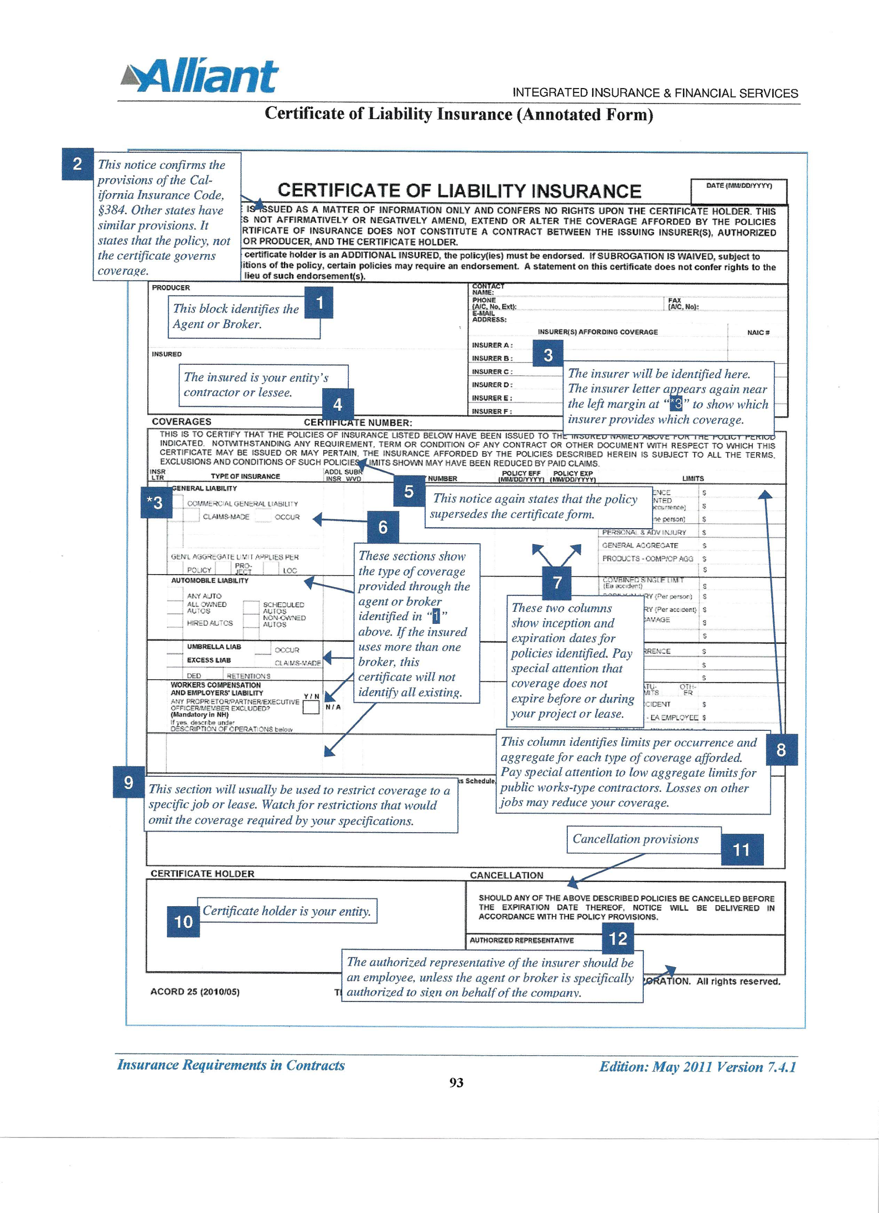
Annotated Sample Certificate in the IRIC Manual
Appendix B
This Photo by Unknown Author is licensed under CC BY-NC

Slide 58
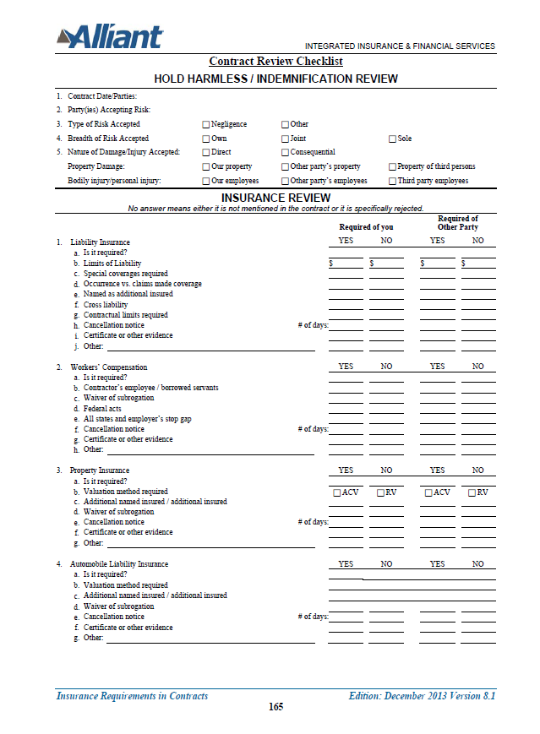
Sample Checklists
This Photo by Unknown Author is licensed under CC BY-NC

Slide 59
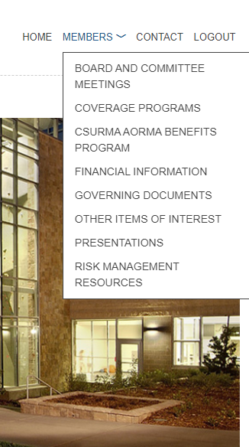
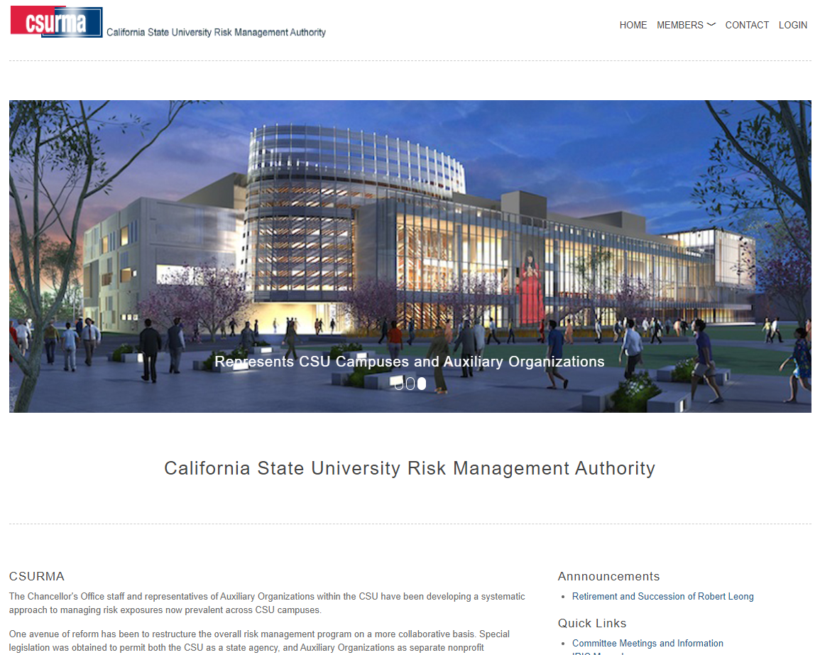
CSURMA Website
Log into the CSURMA website – www.CSURMA.org
Enter Username, Password
Click Login

Slide 60
Conclusion …
Any Questions?

Slide 61
Who to Call w/ Questions
Please contact your Program Administrators:
Amy Lightner – Campus Programs
415-403-1457 amy.lightner@alliant.com
Mimi Long – AORMA Programs
415-403-1423 mlong@alliant.com
Van Rin – Campus and AORMA Program
415-403-1408 vrin@alliant.com
Daniel Howell - Program Director
415-403-1426 dhowell@alliant.com
Or, your friendly Systemwide Risk Management professionals:
Zachary Gifford – Senior Director, CSU Systemwide Risk Management
562-951-4568 zgifford@calstate.edu
Jody Van Leuven – Director, CSU Systemwide Risk Management
562-951-4574 jvanleuven@calstate.edu

Slide 62

The More Rewarding Way to Manage Risk

