Slide 1

CSURMA 101
Fitting the Pieces Together Conference
April 16, 2025
Notes:
Amy / Mimi

Slide 2

Table of Contents
  History … How it all Began
  Organization and Structure
  Financial Highlights
  Core Coverage Programs
  Other Coverage Programs
  Calendar of Events
  CSURMA Website
  Risk Management Resources
  How to Stay Informed
  Who to Call With Questions
Notes:
ADD PICTURES

Slide 3
History … How it All Began

Slide 4
History … How it All Began
1993
1994
1995
Legislation enacted giving operational authority and financial autonomy to the CSU
1997
First CSU Systemwide Risk Manager is hired
Legislation was passed allowing CSU to form a joint powers of authority (JPA) with the CSU auxiliary organizations
CSURMA is created!
Timeline
Notes:
Mimi

Slide 5
Organization and Structure

Slide 6
California State University Risk Management Authority (CSURMA)
Created for the California State University and its Auxiliary Organizations
Providing risk management services and insurance, reinsurance, and self- insurance
Auxiliary Organizations Risk Management Alliance (AORMA)
Operates within CSURMA
Offers tailored coverages for the CSU Auxiliary Organizations
Includes lower deductible and special coverages

Slide 7
Organization and Structure
CSURMA Board of Directors
Board of Directors
(40 seats)
Campuses
(23 seats)
AORMA
(10 seats)
Chancellor's Office
(7 seats)
Annually, each Campus President appoints a Director and an Alternate.
Auxiliary Organizations elect ten Directors from among the AORMA members.
The Chancellor’s Office retains seven seats.
Notes:
ADD PICTURES

Slide 8
CSURMA Executive Committee
Voting Members
Chair, Scott Apel
Vice Chair, Rose McAuliffe
Treasurer, Robert Eaton
Seat 1, Campus Risk Manager, Michael Beatty
Seat 2, Vacant
Seat 3, Campus VP, Colin Donahue
Seat 4, Campus Risk Manager, Lynniece Warren
AORMA Chair, Chuck Kissel
AORMA 1st Vice Chair, Bill Olmsted

Slide 9
CSURMA AORMA Committee
Voting Members
Chair, Chuck Kissel
First Vice Chair, Bill Olmsted
Second Vice Chair, Leslie Levinson
Seat 1, Nicole Lane
Seat 2, Jared Ceja
Seat 3, Cecilia Ortiz
Seat 4, Raven Tyson
Seat 5, John Melikian
Seat 7, Keith Crawford
Seat 6, Rosa Hernandez

Slide 10

Governing Documents
Joint Powers Agreement
Bylaws
Bagley Keene Act
California Fair Political Practices Commission
CSU Policies
CSURMA Policies and Procedures
Memoranda of Coverage (MOC) for Risk Pools
Excess Insurance Policy
Contracts and Agreements

Slide 11
Organization and Structure
Chancellor’s Office
Program Administration
Systemwide Risk Management
Office of General Counsel
Enterprise Accounting
Finance & Investment
Alliant Insurance Services, Inc.
Program Administrators
Systemwide Risk Management
Carl Warren & Company
Sedgwick CMS
HSR, Wellfleet
Equifax
Beazley
Alliant Insurance Services, Inc.
Insurance Brokerage
Claims Administration

Slide 12

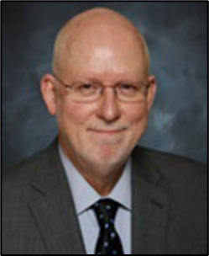
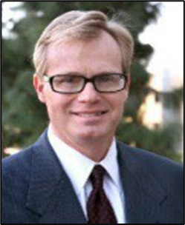
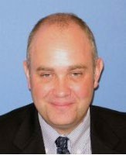
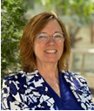
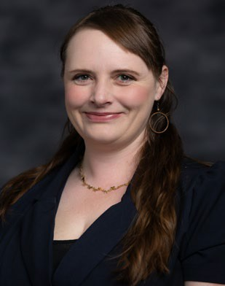
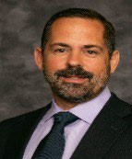
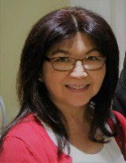
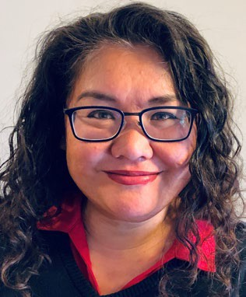
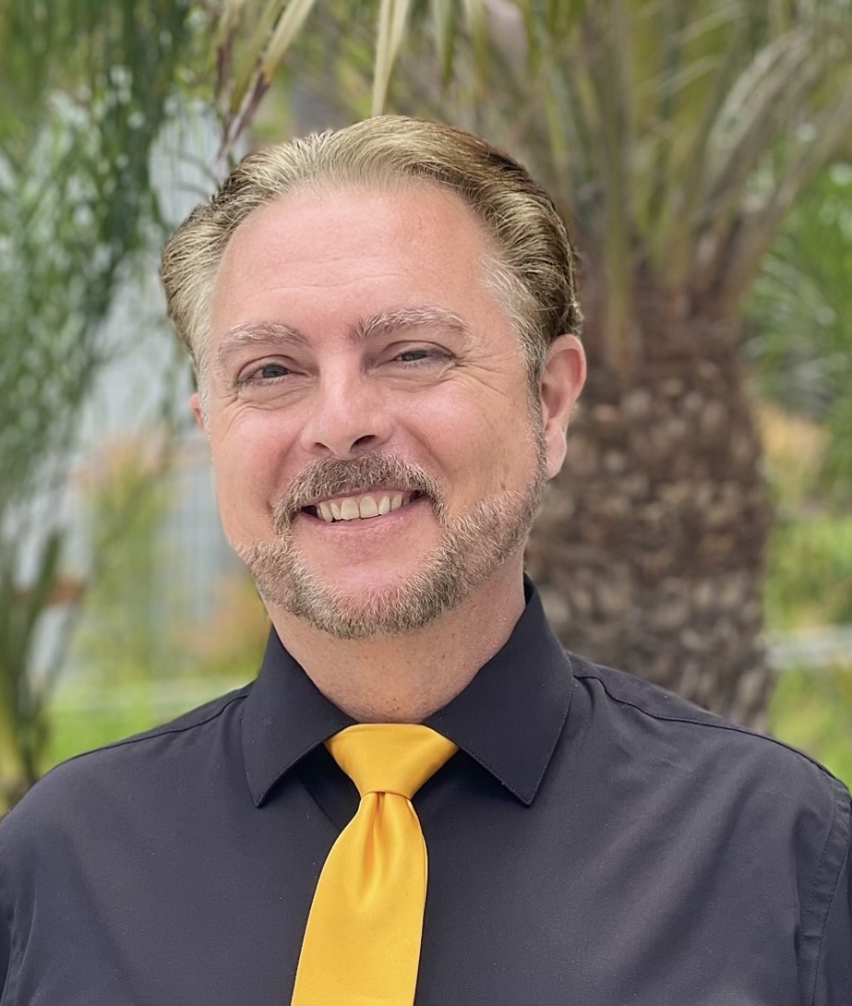
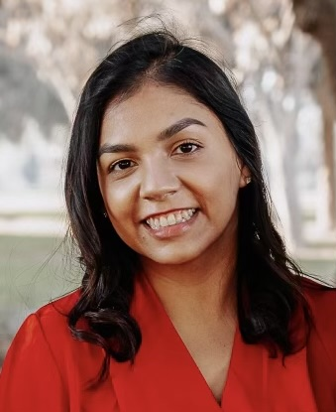
Executive Vice Chancellor and Chief Financial Office
Assistant Vice Chancellor, Financing, Treasury and Risk Management
Business & Finance
and
Systemwide Risk Management
Steve Relyea
Robert Eaton
Senior Director, SW Risk Management
Director,
SW Risk Management
Director, SW
Emergency Management and Continuity
Senior Manager, Risk Management and EH&S
Zachary Gifford
Jody Van Leuven
Jenny Novak
Scott Bourdon
Admin Assistant
General Liability Claims Manager
Emergency and Continuity Manager
EH&S Training and Compliance Administrator
Leona Ching
Martha Guiditta
Andrew Theisen
Marissa Castillo

Slide 13
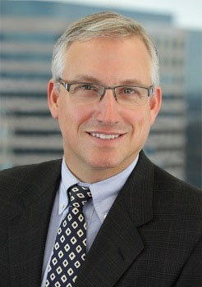
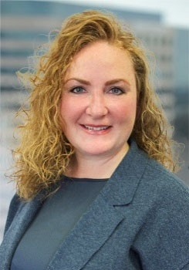
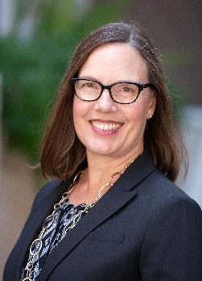
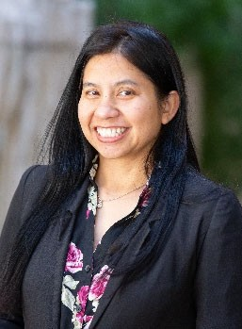
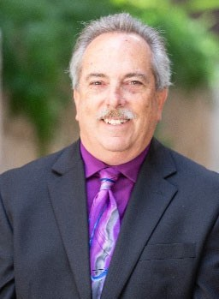
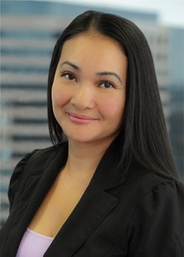
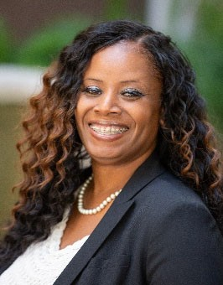
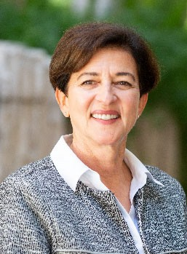
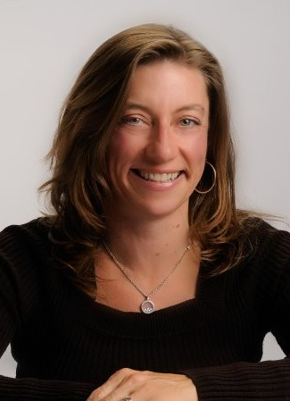
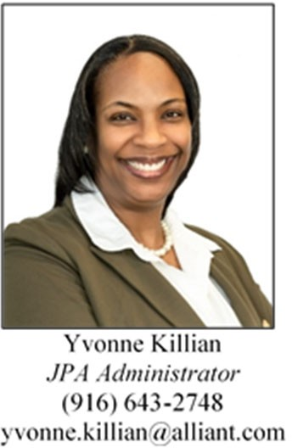
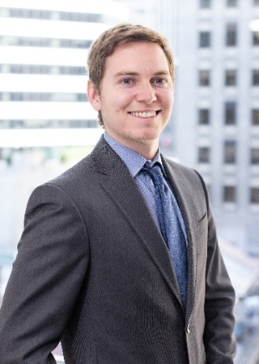

CSURMA Brokerage & Program Administration
Daniel Howell
Amy Lightner
Mimi Long
Van Rin
Bob Frey
Tevea Him
La Shaunda Wallace
Stacey Weeks
Marnie Defosset
Yvonne Killian
Thomas Joyce

Slide 14
CSURMA Financial Highlights

Slide 15
Financial Performance
CSURMA keeps its financial records in accordance with Government Accounting Standards Board (GASB) and produces a comprehensive annual financial report each year. Funds are invested by the CSURMA Treasurer, per the CSURMA Master Investment Policy, to pay expected claims in the risk pools.
Summary of Financial Audit @ June 30, 2024
$75,507,000
$56,233,501
$72,549,000
$71,381,308

Slide 16
Dividends
Total Dividends Returned - $181,771,927

Slide 17
Financial Performance
CSURMA Total Operating Expenses for FY 23/24 - $175,750,374
Claims & Defense Costs: 41% current or future claims.
Insurance Premiums: 53% excess insurance or reinsurance to cover catastrophic claims.
94% of your dollars are used to finance your claims.
Dividends: 1%
Program Expenses: 5%

Slide 18
Core Coverage Programs

Slide 19





Core Campus Programs
Liability
Workers’ Compensation
Property
Auto Liability
Industrial Disability Leave, Non-Industrial Disability Leave, Unemployment Insurance
Athletic Injury Medical Expense

Slide 20


AORMA Core Coverage Programs
Liability
Workers’ Compensation
Property
Auto Liability
Crime
Unemployment Insurance

Slide 21
Other Coverage Programs

Slide 22




Property Coverages
Builders’ Risk Ins Program (BRIP)
Pollution Liability
Owner Controlled Ins Program (OCIP)
Cyber Liability
BRIP covers direct physical loss to CSU’s and/or the AO’s construction projects in the course of construction. All Major Capital Improvement Projects are to be insured by the BRIP in place of the contractor’s insurance. The program is managed by Alliant and CSU’s CPDC.
Available to all Campues and AO’s.
This program provides coverage for owned site clean-up costs, off-site clean-up costs, third-party bodily injury or property damage, emergency response costs, business interruption.
All Campuses and AO’s participate.
OCIP covers major building projects of the CSI and/or AOs with initial construction cost of $10M or more. OCIP includes General Liability, Completed Operations and Workers’ Compensation coverage for all contractors. This program is managed by Alliant and CSU’s CPDC.
Available to all Campuses and AO’s.
This program is designed to provide insurance coverage for both first and third-party financial losses resulting from data breaches and other cybercrimes that may compromise sensitive information.
All Campuses and AO’s participate.
Contributions managed through CPDC.
Contributions included in the Campus Property or AORMA Program.
Contributions managed through CPDC.
Contributions included in the Campus or AORMA Property Program.

Slide 23

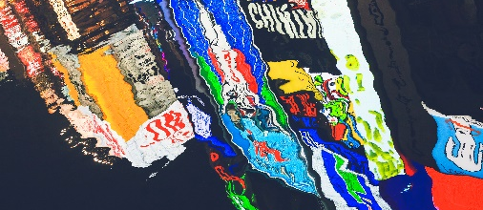


Property Coverages
Earthquake w/ Parametric Trigger
Fine Arts, Artifacts & Archives
Inland Marine
Automobile Physical Damage
Provides Systemwide earthquake coverage. The limit for each location is predetermined based on zip code and maximum shaking at that particular location. The deductible is a minimum trigger intensity of 45.00%g – Pseudo-Spectral Acceleration with a period of 0.3s.
All Campuses and AO’s participate.
Provides coverage for art objects that are owned or lent to the University or auxiliary organizations. Coverage includes transit coverage while the art objects are transported to or away from the campus; i.e., coverage is “nail-to-nail” or “wall-to-wall”.
All Campuses and AO’s participate.
Provides “All Risk” coverage for scheduled specific objects such as:
Computers, media, laptops
Scientific and laboratory equipment
Cameras, audio, industrial lighting
Specialized mobile equipment; etc.
Available to all Campuses and AO’s. Each item must be scheduled to be covered.
Provides “All Risk” coverage for scheduled vehicles and/or mobile equipment.
Available to all Campuses and AO’s. Each item must be scheduled to be covered.
Contributions included in the Campus and AORMA Property Program.
Contributions included in the Campus and AORMA Property Program.
Contributions are calculated and invoiced quarterly and sent directly to Campus or AO.
Contributions are calculated and invoiced quarterly and sent directly to Campus or AO.

Slide 24




Student Coverage Programs
Club Liability Insurance Program (CLIP)
Club Sports Insurance Program
Student Travel Accident Insurance
Participation Accident Insurance Program (PAI)
CLIP provides general liability coverage for all student clubs. The program excludes coverage for auto liability, activities of fraternal organizations as well as injuries to participants participating in athletic activities.
Automatic coverage for all officially recognized student clubs (per Executive Order #1068).
Covers CSU students for general liability, and medical expenses due to accidental injuries while participating in the CSU’s or AO’s club sports, intramural and recreational sports.
Coverage is available to all Campuses and AO’s. Sport type and # of participants must be scheduled.
Provides medical expense coverage for injuries to CSU students (including Extended Education Program students) during travel to, or from, campus to participate in a school sponsored activity. Additionally, coverage for overnight supervised and sponsored travel is included for up to 14 days.
All Campuses and AO’s participate.
PAI provides accident medical expense benefits and is recommended when the CSU or AO is sponsoring a high hazard activity or when minors are participating in a sponsored activity.
Available to all Campuses and AO’s.
Contributions are included in the Campus Liability Program. No charge for AORMA.
Contributions are invoices separately.
Contributions included in Campus Liability Program. No charge for AORMA.
Contributions are invoiced separately.

Slide 25


Student Coverage Programs
Student Professional Liability Ins Program (SPLIP)
Student Academic Field Experience for Credit Liability Ins Program (SAFECLIP)
Systemwide professional liability insurance to provide coverage for students enrolled in the Nursing, Allied Health or Education internship curricula. This program is designed to satisfy the requirements of host institutions that students maintain professional liability insurance in order to participate in programs offered under affiliation agreements with the University. The program includes professional and personal liability coverage with broad protection for the students, affiliates and the University.
Available to all Campuses.
Provides coverage for students involved in the University’s service-learning programs while performing service or volunteer work for academic credit. This program is designed to satisfy the requirements of host institutions that students maintain liability insurance in order to participate in programs offered under affiliation agreements with the University. The program includes professional and general liability coverage with broad protection for the students, affiliates and the University.
Available to all Campuses.
Contributions are included in the Campus Liability Program.
Contributions are included in the Campus Liability Program.

Slide 26



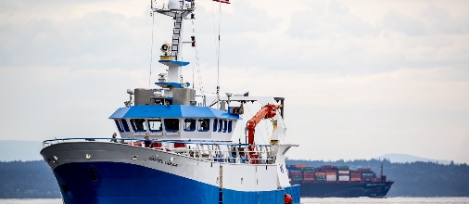
Aviation / Watercraft Coverages
Drone Insurance Program
Non-Owned Aircraft Liability
Rocketry Liability
Watercraft Insurance Program
Covers aviation risks on a blanket basis for liability arising from small drones that are owned, non-owned or hired by CSU or its AO’s. Coverage is automatic for non-commercial use of small drones only. Hull coverage can be purchased separately.
All Campuses and AO’s participate.
As CSU occasionally uses non-owned aircraft for CSU business, a special Aviation Liability policy was placed to insure against non-owned aircraft liability.
All Campuses and AO’s participate.
CSURMA purchases a special Aviation Liability insurance policy to facilitate coverage for the University’s liability arising from rocketry activities.
All Campuses and AO’s participate.
Provides Hull and Machinery Insurance, Collision and Towers Liability coverage, Protection and Indemnity Liability coverage.
This is not a blanket coverage; each vessel must be reported and scheduled on the policy.
Contributions are included in the Campus and AORMA Liability Program.
Contributions are included in the Campus Liability Program. No charge for AORMA.
Contributions are included in the Campus Liability Program. No charge for AORMA.
Contributions are invoiced separately.

Slide 27
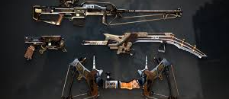



Miscellaneous Coverage Programs
Deadly Weapons Response Program
Fidelity / Crime Insurance Program
Medical Professional Malpractice Liability Insurance
Trustees E&O, and Fiduciary Liability
Addresses the needs of the CSU system should a violent incident occur. The program provides third party liability, physical damage coverage and crisis management services.
Automatic coverage for all Campuses and AO’s.
Insures the CSU’s and AO’s and auxiliary organization’s employees for Employee Fidelity, including faithful performance of duties, counterfeit, fraud, computer crime, and other misappropriation of the funds.
All Campuses and AO’s participate
This program provides Medical Professional Malpractice Liability insurance for Medical Professionals employed by the CSU or its Campuses for services performed within the course and scope of their duties as employees while serving at the Student Health Center on a campus of the CSU.
All Campuses participate.
This program provides professional liability for the various CSURMA board and committee members, while serving in their capacity as such. This program also provides Fiduciary Liability coverage for the Campuses and AO’s administration of its employee benefit plans and trusts.
Automatic for all Campuses and AO’s.
Contributions included in the Campus and AORMA Property Program.
Contributions included in the Campus Liability Program and the AORMA Crime Program.
Contributions included in the Campus Liability Program.
Contributions included in the Campus and AORMA Liability Program.

Slide 28


Miscellaneous Coverage Programs
Special Event Insurance Program
Foreign Travel Insurance Program (FTIP)
The Special Events Program offers premises liability coverage for a broad range of events held by uninsured third parties in public assembly facilities. The program has the added feature of allowing the CSU and its auxiliary organizations to insure its own events as circumstances warrant.
Available to all Campuses and AO’s.
This program provides coverage for employees and students while traveling outside the United States. Coverage includes General Liability, Contingent Auto Liability, Employee Benefits Liability, Employers Responsibility, Employee Voluntary Compensation, Employers Liability, Primary Accident and Sickness, Accidental Death and Dismemberment, and Executive Assistance Services. Beginning July 1, 2014, FTIP added an “Overlay” coverage to supplement the insurance mandated by certain third-party travel program providers under approved agreements with the University. Specifically, the overlay coverage extends FTIP’s Liability insurance that is not otherwise provided by certain third-party programs.
Available to all Campuses and AO’s. All international travel must be reported to obtain coverage.
Invoiced separately.
Invoiced separately.

Slide 29
Calendar of Events

Slide 30





CSURMA Calendar of Events
Risk Pool Funding
XS Ins Budgeted
EC & BOD Approvals
“Early-Bird” Letter
Marketing submission sent to all viable insurers.
Jun - Aug
Oct - Apr
June 30
Aug - Nov
Mar - Jun
Gather Member Exposure information
Coverage Bound!
Fiscal Year Ends
Claims Information Finalized
Actuarial Analysis Received

Slide 31
CSURMA Website

Slide 32
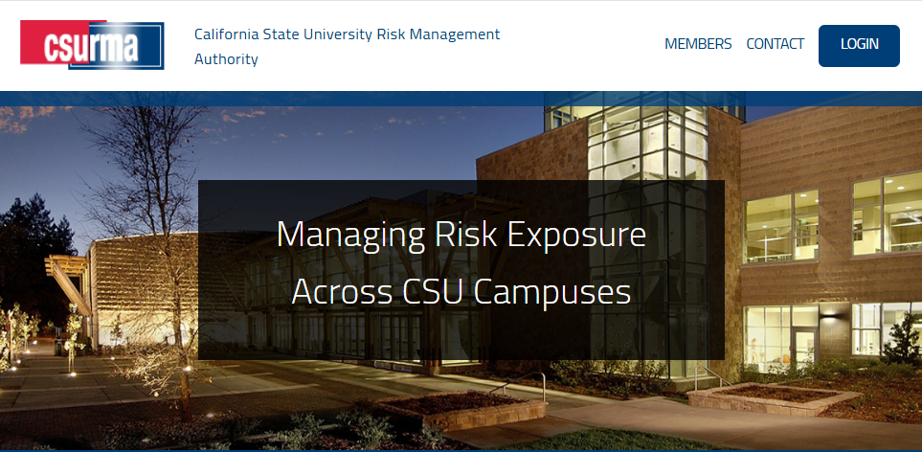
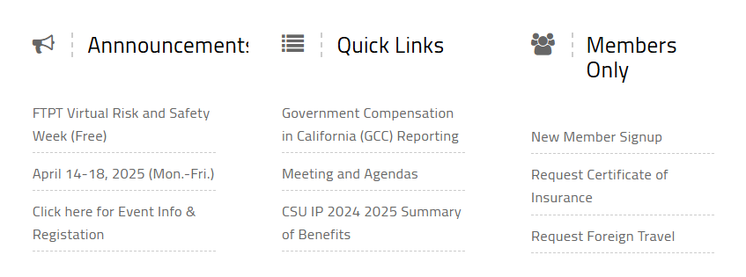
www.CSURMA.org

Slide 33
Crisis Response Resources

Slide 34
Risk Management Resources

Slide 35
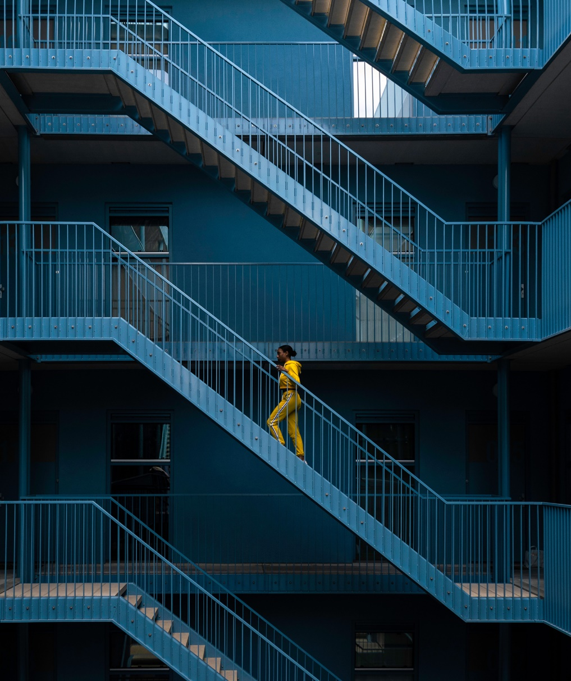
Risk Management Resources
Systemwide Emergency Management Resources
Agility Recovery Solutions, Inc. – Continuity of operations and disaster recovery services including assistance with office space, power, communication, computers after major disaster or planned shutdown.
Black Swan – Crisis solutions for critical events around the world, including mass fatality incidents, terrorist acts, active shoot situations, natural disasters and more. Based on scale of incident, scope of response may include:
Incident Response Contact Center
Survivor and Family Assistance Center
Deployment of counselors onsite
VEOCI – Collaboration, continuity and response software to help ensure organizational resilience and successful crisis management.

Slide 36
Risk Management Resources
Property Restoration – 24-Hour Emergency Hotlines:
BELFOR - 800-856-3333 (CSU MEA)
ServPro - 866-388-2479 (CSU MEA)
ATI - 800-400-9353 (No MEA)
Provides property recovery and restoration services to restore structures damaged as a result of fire, flood, nature disasters, etc.
Insurance Requirements in Contracts Manual - The CSURMA custom IRIC manual serves as a guide in developing proper insurance requirement in contracts and verifying compliance with those requirements.
Praesidium – Unlimited online youth protection training as well as additional youth protection services.
Special Events Resource Guide - The purpose of this resource guide is to support the CSU mission to enrich its students and communities through hosting special events.

Slide 37
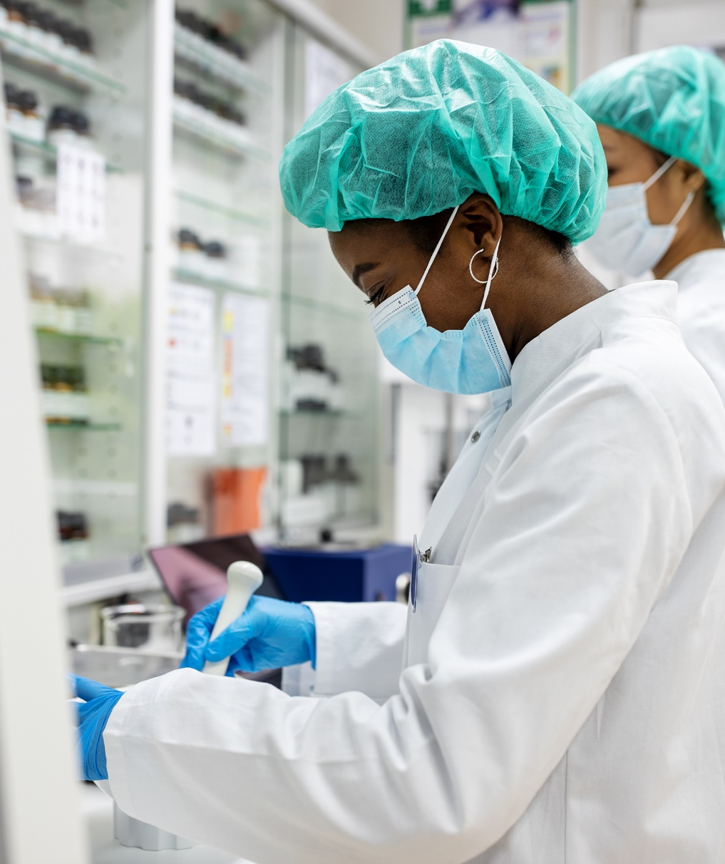
Risk Management Resources
Campus Specific Resources
UC Risk & Safety Solutions - Provides access to inspection checklists, lab safety assessment, lab roster module, chemical management system (two modules – chemical inventory and chemical administration), and service desk support.
Innovation Grant Program – Provides funds for risk management and safety projects at the Systemwide level. Grant applications are submitted through the CSU’s affinity groups.

Slide 38
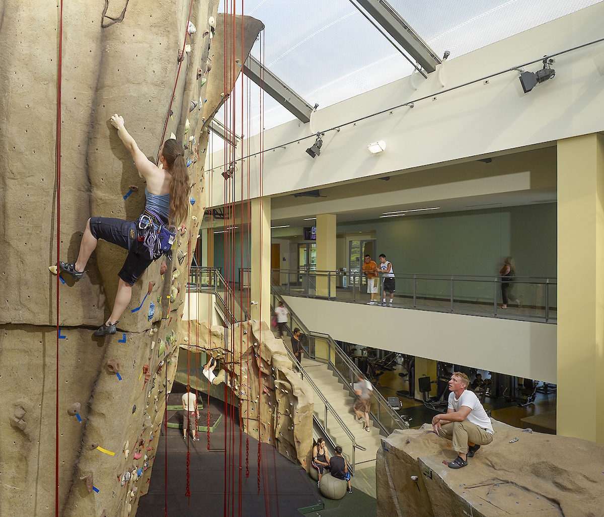
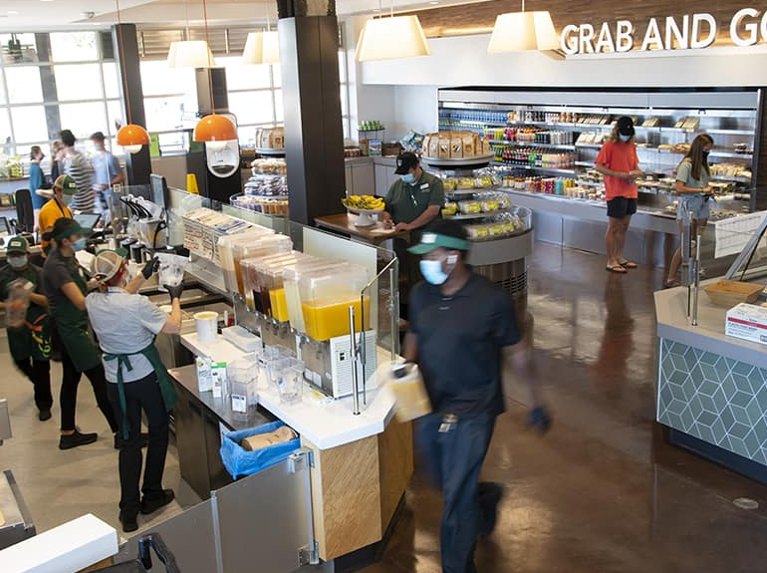
Risk Management Resources
AORMA Specific Resources
ALLIANT RISK CONTROL CONSULTING – In person safety inspections, consulting and training.
EMPLOYERS GROUP, INC. - Provides HR consulting, on-line access to BNA’s HR essentials, access to a staffed HR reference center, monthly HR newsletters, weekly legal updates, access to compensation & benefits surveys

Slide 39
How to Stay Informed

Slide 40

How to Stay Informed?
Fitting the Pieces Together Conference
AOA Conference
CSURMA Website (www.CSURMA.org)
CSURMA Board meetings
Committee meetings
Campus Visits
Campus “early-bird” letter
CSURMA Annual Report

Slide 41
Who to Call With Questions?

Slide 42
Who to Call?
Please contact your Program Administrators:
Amy Lightner – Campus Programs
415-403-1457 amy.lightner@alliant.com
Mimi Long – AORMA Programs
415-403-1423 mlong@alliant.com
Van Rin – Campus and AORMA Program
415-403-1408 vrin@alliant.com
Daniel Howell - Program Director
415-403-1426 dhowell@alliant.com
Or, your friendly Systemwide Risk Management professionals:
Zachary Gifford – Senior Director, CSU Systemwide Risk Management
562-951-4568 zgifford@calstate.edu
Jody Van Leuven – Director, CSU Systemwide Risk Management
562-951-4574 jvanleuven@calstate.edu

