Slide 1

State of the Public Entity Insurance Market & Evolving Risks
January 2022
Presented by:
Your name here
(THIS INFORMATION HAS BEEN CONSOLIDATED FROM VARIOUS INDUSTRY SOURCES)

Slide 2

Presentation Overview
Highlights
Property/Casualty Industry Performance
The New Reality – Evolving Risks
Toward the Future

Slide 3
Highlights
Global insured catastrophe losses in the year 2021 are expected to rise to $112 billion, the fourth highest on record, with Hurricane Ida being the main loss-making event, according to an estimate by Swiss Re Institute.
U.S. Wildfires, Storms, and ‘Social Inflation’ continue to create intense pressure on insurers, causing insured losses in the billions, and while COVID -19 has of course added new types of losses to the mix, more so, it has created additional uncertainty which is adding to an already challenging insurance marketplace.
Winter storm Uri caused an estimated USD $20 billion insured losses in the U.S., the highest ever recorded for this peril in the country.
Source: A.M. Best, ISO, Verisk, Property Casualty Insurers Association of America (PCI)

Slide 4

Key Industry Metrics
  Insurers’ combined ratio was 96.9% for H1 2021; improving from prior year by 2.9%.
  Policyholder surplus rose 7.2% from year end 2020 to $972.4B.
  Net underwriting income for H1 2021 increased 27.9% from the prior period; as a 5.4% growth in net earned premiums and 55.3% decline in policyholder dividends offset the increases in incurred losses and loss adjustment and underwriting expenses.
  Signs point to a healthy, yet unsettled, insurance market, due to the unknowns of COVID-19 Variants, weather extremes, sea level rise, wildfires, catastrophic losses, social inflation and investment earnings. All remain areas of concern for insurers.
Source: A.M. Best, ISO, Verisk, Property Casualty Insurers Association of America (PCI)

Slide 5

Property/Casualty Industry Performance

Slide 6
Q3 2021 U.S. commercial insurance prices grew again in the third quarter
Data for nearly all lines continue to indicate significant price increases in the 3rd quarter.
Both excess/umbrella liability and directors & officers liability reported significant price increases though lower than those in the 2nd quarter of 2021.
Commercial auto saw reported price increases near or above double digits for the sixteenth consecutive quarter, while property coverage accelerated again and saw near or above double digit increases for the tenth consecutive quarter.
Source: Willis Towers Watson Commercial Lines Insurance Pricing Survey

Slide 7
Policyholder Surplus (Capacity),
2006:Q4–2020:Q4E and 2021F*
The P/C insurance industry entered the COVID-19 pandemic from a position of strength and was able to withstand the 9.0% surplus decline in Q1 2020 (far less than during the Financial Crisis). 2020 ended with record surplus. 2021 will likely set another new record, reaching $1 trillion for the first time.
($ Billions)
Financial Crisis (-16.2%)
Drop due to near-record 2011 CAT losses (-4.9%)
Policyholder Surplus is the industry’s financial cushion against large insured events, periods of economic stress and financial market volatility. It is also a source of capital to underwrite new risks.
2010: Q1 data includes $22.5B of paid-in capital from a holding company parent for one insurer’s investment in a non-insurance business.
*2021 is an estimate. Actual through H1 = $974.904
Sources: ISO, A.M .Best; Risk and Uncertainty Management Center, University of South Carolina.
7
12/01/09 - 9pm
eSlide – P6466 – The Financial Crisis and the Future of the P/C
Notes:
7

Slide 8
Net Premium Growth (All P/C Lines): Annual Change, 1971–2021F
2021F: 4.6%*
2020: 1.8%
2020:Q3: 3.1%
2019: 3.6%
2018: 10.8%
2017: 4.6%
2016: 2.7%
2015: 3.5%
2014: 4.2
2013: 4.4%
2012: +4.2%
(Percent)
1975-78
1984-87
2000-03
Net Written Premiums Fell 0.7% in 2007 (First Decline Since 1943) by 2.0% in 2008, and 4.2% in 2009, the First 3-Year Decline Since 1930-33.
2020 Outlook
Pre-COVID: 3.8%
Actual: 1.8%**
* **Pre/Post-COVID-19 forecast from A.M. Best Review & Preview (Feb. 2020, 2021). NOTE: Shaded areas denote “hard market” periods
Sources: A.M. Best (1971-2013, 2021F), ISO (2014-19); Risk & Uncertainty Management Center, Univ. of South Carolina
8

Slide 9
COVID’s Impact on NPW Growth for Largest P/C Lines: 2020
Personal Auto insurers returned $8B to policyholders in 2020, but net change in NPW was just $4.2B (same as WC)
Percent Change
Workers Comp, Inland Marine and PP Auto Liability have experienced the largest decline in DPW
Down $4.2B
*Inland Marine figure is DPW though first 9-months of 2020 (A.M. Best).
Sources: NAIC Annual Statement data, NCCI; Risk and Uncertainty Management Center, Univ. of South Carolina.
9

Slide 10
Change in Commercial Rate Renewals, by Line: 2021:Q2
Cyber is seeing record increase, in response to major breaches in 2020 and 2021, overtaking Commercial Umbrella
Percentage Change (%)
All major commercial lines experienced increases in Q2 2021
Note: CIAB data cited here are based on a survey. Rate changes earned by individual insurers can and do vary, potentially substantially
Source: Council of Insurance Agents and Brokers; USC Center for Risk and Uncertainty Management.
10

Slide 11
P/C Industry Net Income After Taxes, 1991–2021:Q1*
2005 ROE= 9.6%
2006 ROE = 12.7%
2007 ROE = 10.9%
2008 ROE = 0.1%
2009 ROE = 5.0%
2010 ROE = 6.6%
2011 ROAS¹ = 3.5%
2012 ROAS¹ = 5.9%
2013 ROAS¹ = 10.2%
2014 ROAS¹ = 8.4%
2015 ROAS = 8.4%
2016 ROAS = 6.2%
2017 ROAS =5.0%
2018 ROAS = 8.0%
2019: ROAS = 7.7%
2020: ROAS = 6.8%
2021: ROAS = 8.7%*
$ Millions
COVID’s impact on net income was more modest than anticipated, a decline of 3.7%
*2021 is through Q1. ROE figures are GAAP; ¹Return on avg. surplus. Excludes Mortgage & Financial Guaranty insurers for years (2009-2014).
Sources: A.M. Best, ISO.
11

Slide 12
P/C Insurance Industry Combined Ratio, 2001-2021F**
Pre-COVID 2020 Combined Ratio Est.
99.1 (A.M. Best)
Actual = 98
As Recently as 2001, Insurers Paid Out Nearly $1.16 for Every $1 in Earned Premiums
Relatively Low CAT Losses, Reserve Releases
Higher CAT Losses, Shrinking Reserve Releases, Toll of Soft Market
Relatively Low CAT Losses, Reserve Releases
Sharply higher CATs are driving large underwriting losses and pricing pressure
Heavy Use of Reinsurance Lowered Net Losses
Avg. CAT Losses, More Reserve Releases
COVID-19 has had no discernable net impact on pre-COVID expectations for the combined ratio in 2020;
-7.5 pts. due to CATs vs. 4.1 in 2019 (about twice avg.)
Cyclical Deterioration
Lower CAT Losses
Best Combined Ratio Since 1949 (87.6)
Sandy Impacts
*Excludes Mortgage & Financial Guaranty insurers 2008–2014.
**2021 forecast from A.M. Best Review and Preview (Feb. 2021).
Sources: A.M. Best, ISO (2014-2019).
12

Slide 13

Take Aways
California has unique challenges, underwriting scrutiny due to continued liability loss development.
Policyholder surplus continues to rebound from an initial dip related to COVID-19 and has rebounded to historic highs. Signifies overall market health.
COVID-19 claim impacts are not fully developed, but clearly adversely impact society, financial institutions and insurance markets. Inflationary trends arise.
Combine ratio remains close to 100 despite increased rates, leading to financial and underwriting pressure to continue increasing rates.
13

Slide 14

Impact of Natural Catastrophes

Slide 15
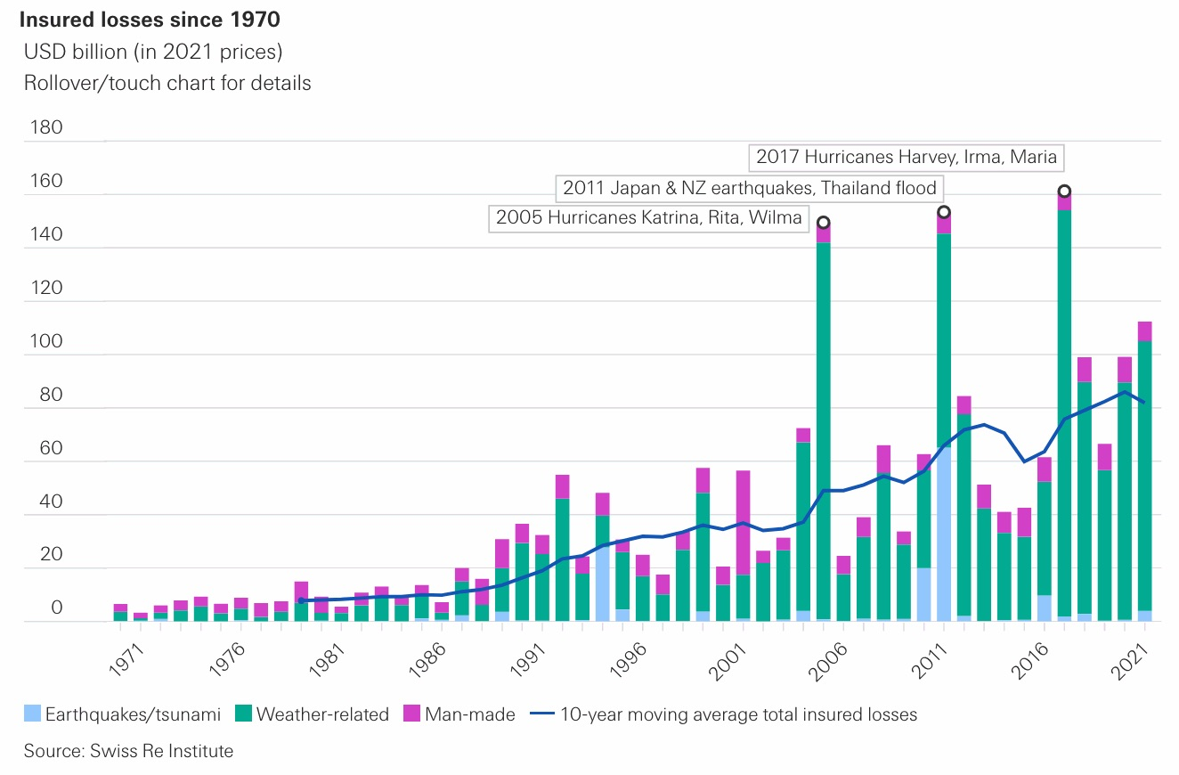
Insured CAT losses since 1970

Slide 16
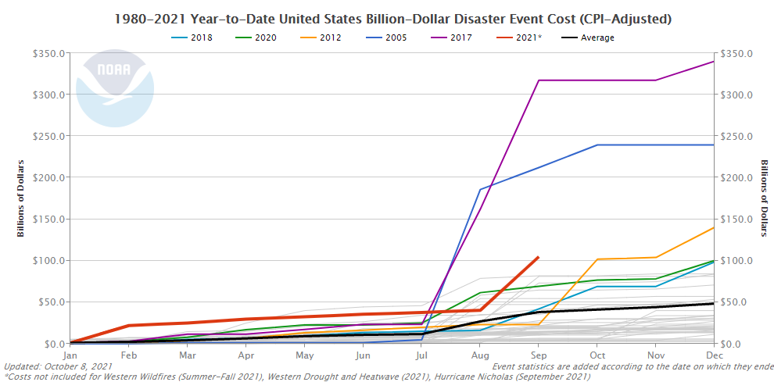
Six most severe Cat Loss Years on Record (all recent)

Slide 17
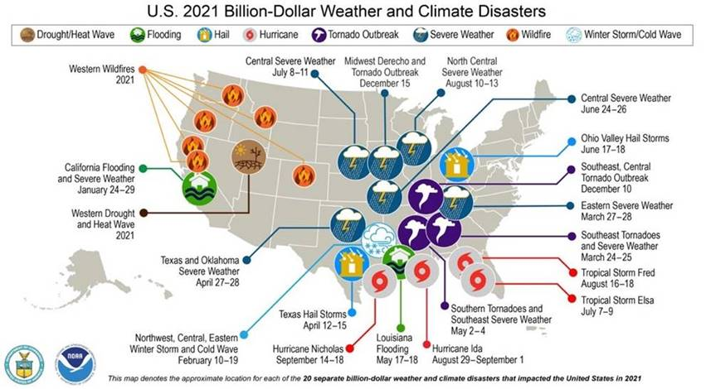
17

Slide 18
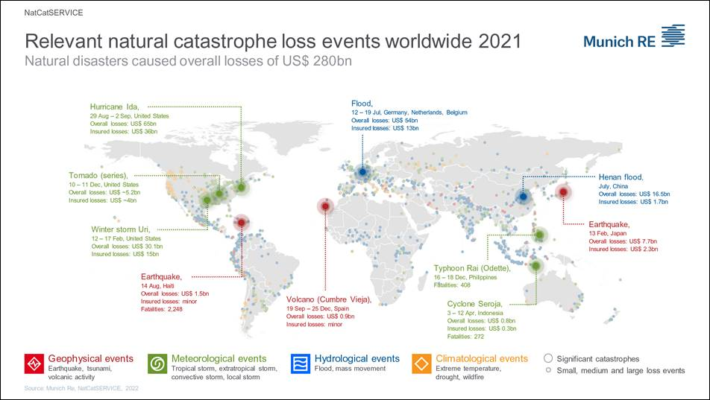

Slide 19
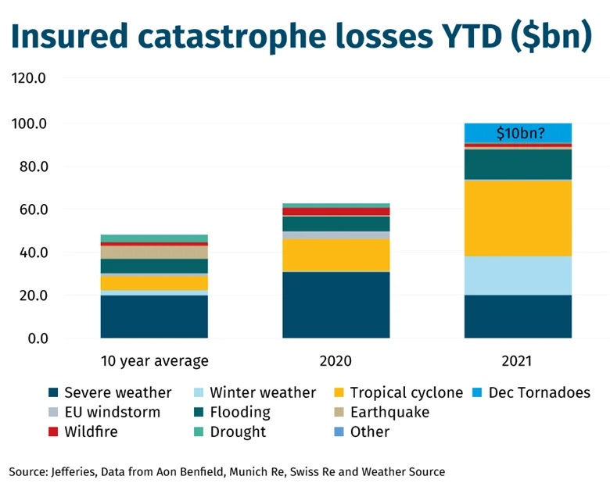
Insured CAT Losses

Slide 20
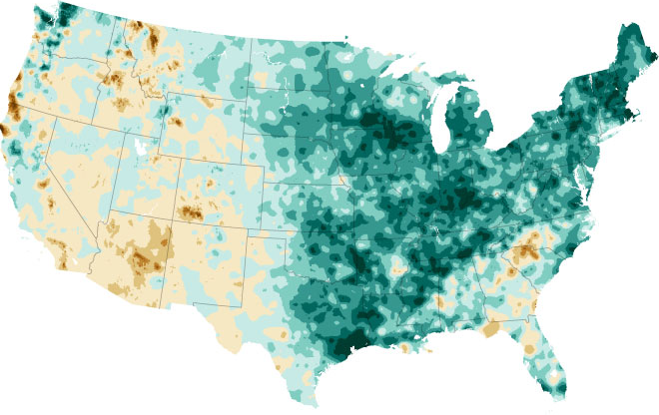
Climate Change & Catastrophic Loss
Key takeaways from the UN report on the climate crisis:
Heat Waves -- Extreme heat waves, such as the deadly one that occurred in the Pacific Northwest and Canada earlier this summer, are already about five times more likely to occur with our current warming of just over 1 degree Celsius.
Droughts -- Climate change is increasing the frequency and severity of droughts -- such as the current drought plaguing the Western United States.
Flooding -- Climate change is intensifying the water cycle on both sides. While more intense evaporation will lead to more droughts, warmer air can hold more water vapor to produce extreme rainfall.
Hurricanes -- Hurricanes are growing stronger and producing more rain as global temperatures increase. It has already been observed that, globally, a higher percentage of storms are reaching the highest categories (categories 3, 4 and 5) in recent decades.
Sea level rise-- Sea level is rising around the world, and the rate is increasing. This is worsening high-tide flooding and storm surge.

Slide 21
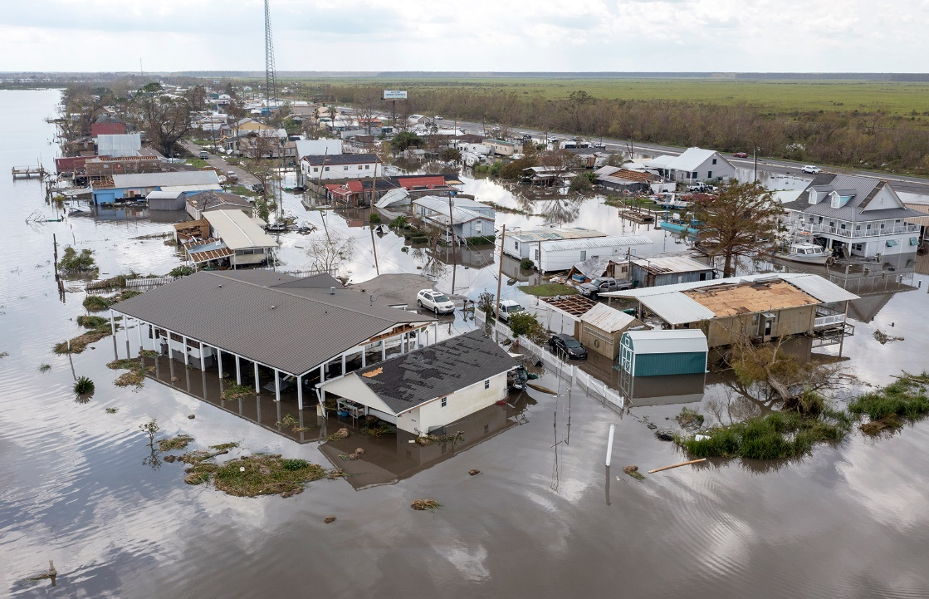
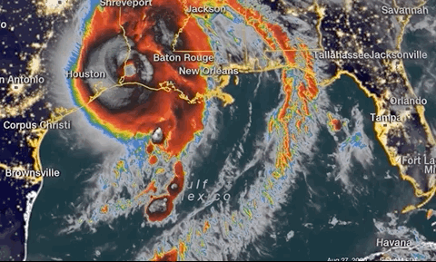
Hurricanes
Potential threats from hurricanes include powerful winds, heavy rainfall, storm surges, coastal and inland flooding, rip currents, tornadoes, and landslides.
Hurricane Ida affecting Louisiana
August 2021
Hurricane Laura affecting Gulf Coast
August 2020

Slide 22
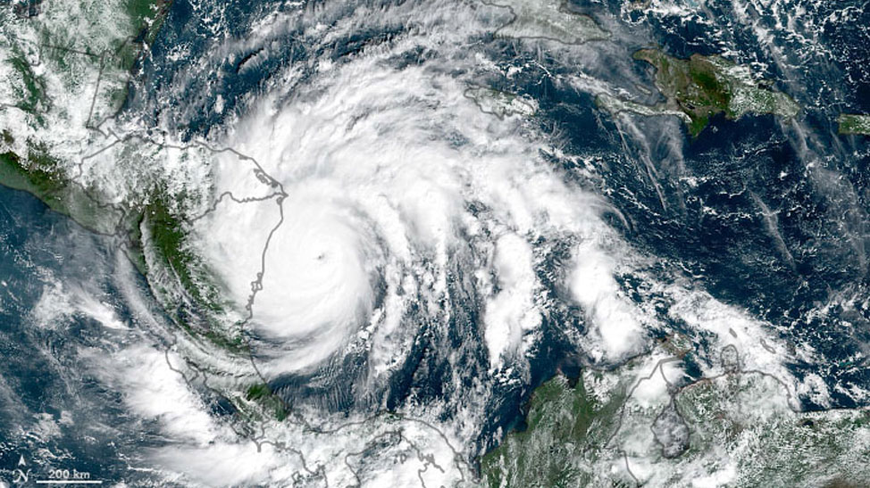
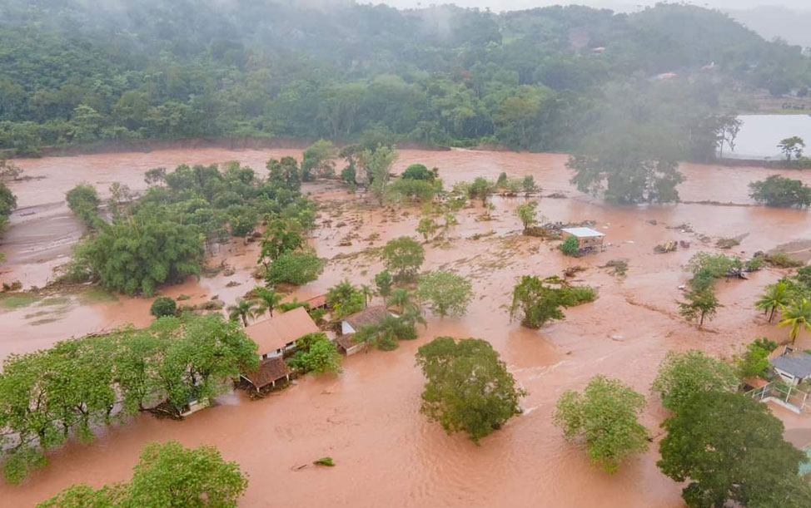
2021 Hurricane Season
The extremely active 2020 Atlantic hurricane season closed with a record-breaking 30 named storms and 12 landfalling storms in the continental United States.
The 2021 season came to a close with 21 named storms, 7 hurricanes, or which four were major hurricanes.
The 1981 to 2010 average has been 12.1 named storms, with 6.4 hurricanes and 2.7 major hurricanes.

Slide 23
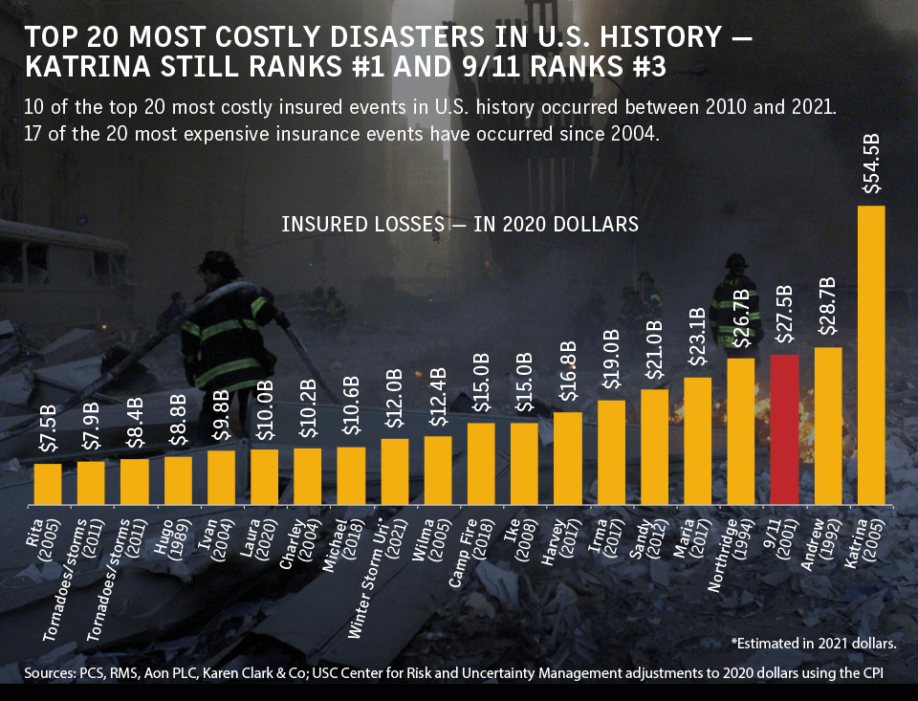
Top 20 Most Costly Disasters in U.S. History

Slide 24
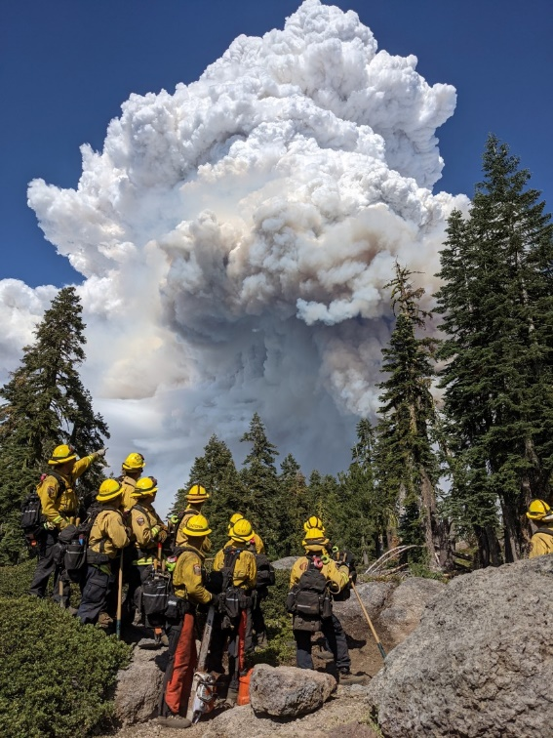
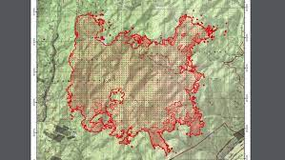
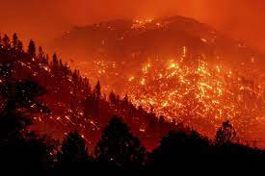
Wildfires
The Marshall Fire in Boulder County about 20 miles northwest of Denver is believed to be the most destructive fire in Colorado history: 600 homes, a shopping center and a hotel were destroyed; causing billions in damage.
The 2021 season was a record-setting one for the state of California and the United States as a whole. According to Calfire, the Dixie fire was the second largest fire on record in the state, and burned 963,309 acres and destroyed 1,329 structures in five counties and damaged 95 structures. More than $630 million in costs was incurred in suppressing the Dixie fire. PG&E has been expected to lose $1.15B.

Slide 25
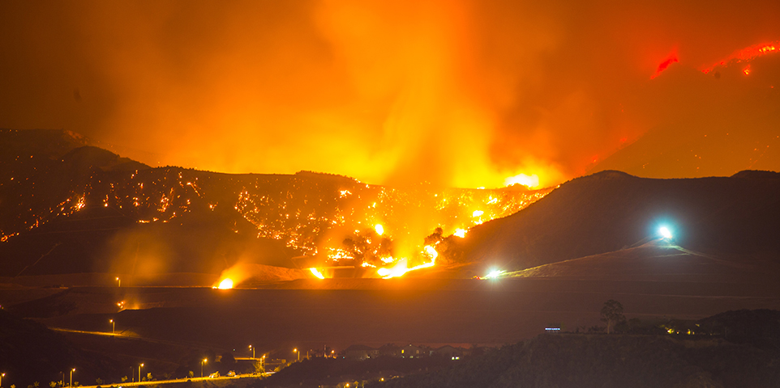
Wildfires
“The total damage and cumulative economic loss for the 2021 wildfire season is expected to be between $70 billion and $90 billion in the U.S. with $45 billion to $55 billion of those damages to California alone.” (AccuWeather)
Insured losses from wildfires in the U.S. have exceeded $13 billion and economic losses have topped $20 billion in three of the last four years, according to Aon.

Slide 26
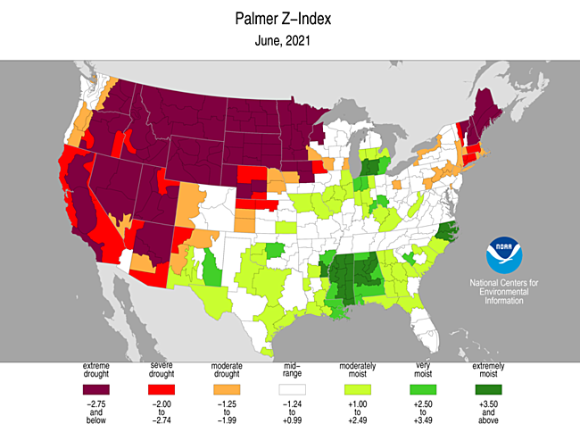
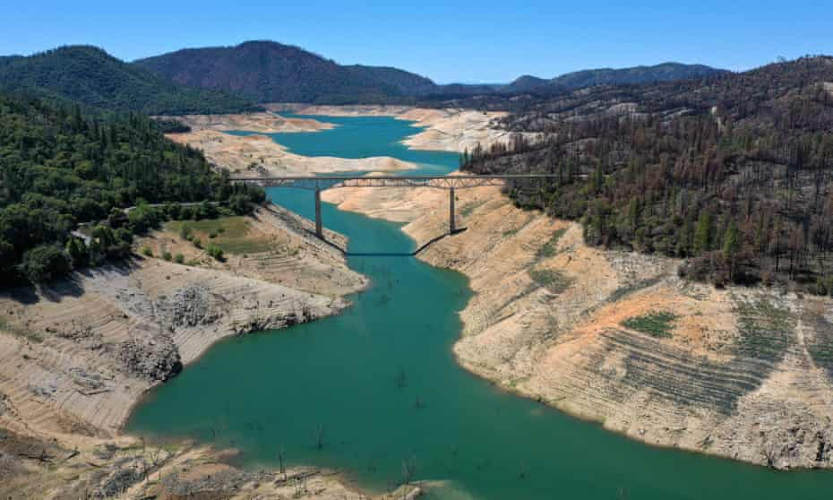
Droughts
Drought is characterized by deficit — of rainfall, snow, runoff into rivers, storage in reservoirs and more. And all of these factors are in dire shape this year.
Much of California has received less than half of average rain and snowfall since October of 2020, with some areas seeing as little as a quarter. For most of Northern California, the past two years have been the second driest on record.

Slide 27
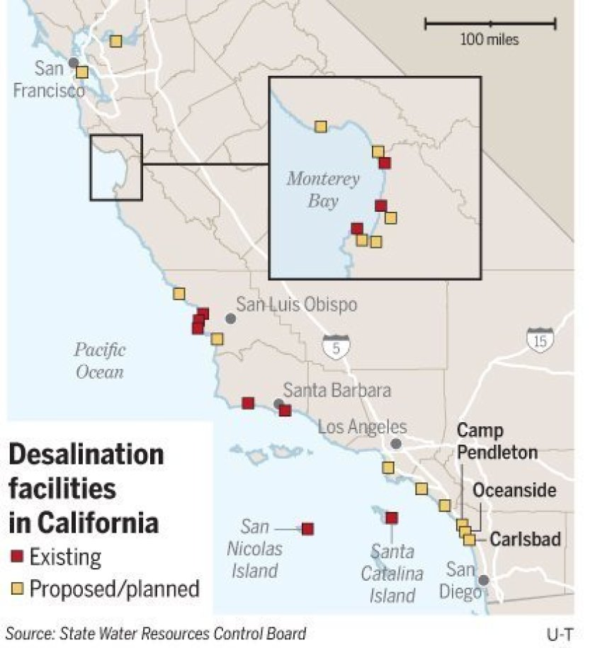
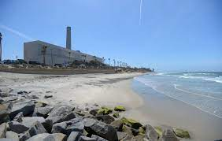
Droughts & Desalination
Desalination is the process of converting seawater into drinking water by removing its salt content.
California currently has 12 seawater desalination facilities in operation.
The Alameda County Water District built the Newark desalination facility to treat groundwater near the San Francisco Bay that had been contaminated with bay water. Whereas before it would just pump out the saltier water, now it treats it and produces about 12 million gallons per day, or about 25% of the overall water supply for the Southern Alameda County area.

Slide 28
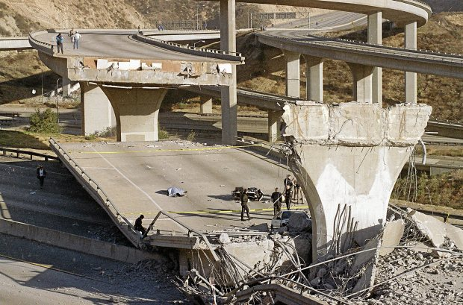
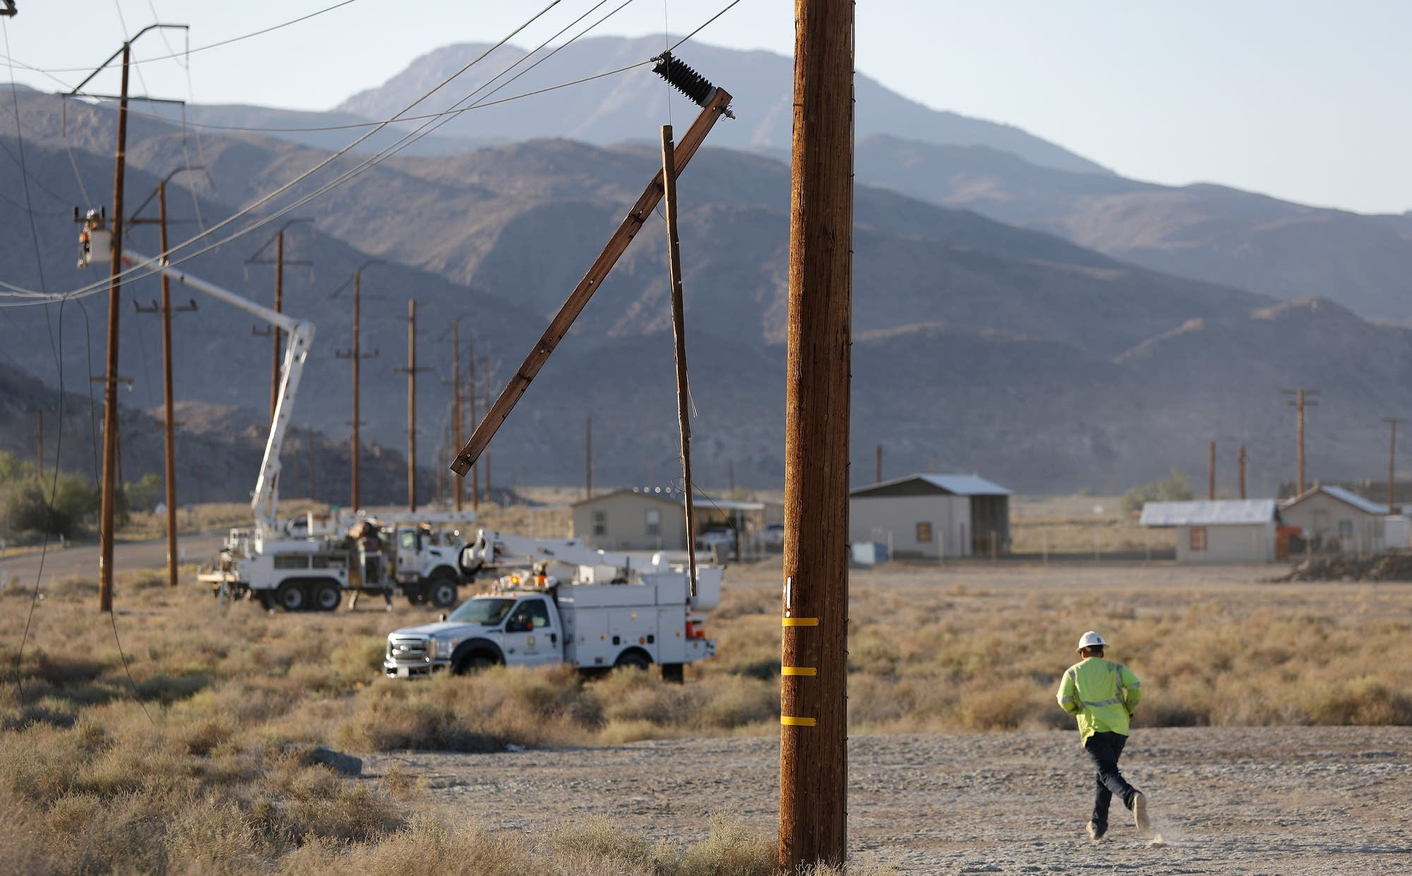
Earthquakes
Not to be overlooked, Earthquakes are inevitable and can happen at any time.
Economic impacts of an earthquake can be devastating on first party property, and expected business revenues.

Slide 29
How was 2021?

Slide 30
Take Aways
Catastrophic events have been occurring with greater intensity and frequency. Insurance markets are reacting with underwriting and pricing changes.
Risk modeling continues to lead underwriting focus and climate impacts have worsened the outlook for wet and dry lands.
California’s exposure to catastrophic property losses from wildfire has upended the property market. Fires continue to increase in size and frequency, a troubling trend.
30

Slide 31
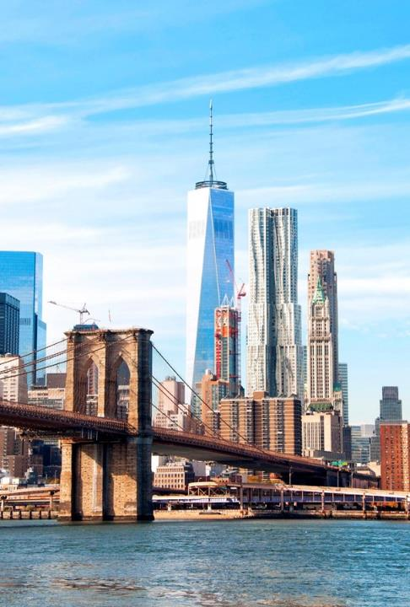
The New Normal

Slide 32
The Landscape
Insurance Landscape:
  Markets have contracted
  Underwriting has become more conservative
  Variability further challenges the market
Workforce:
  Remote work: new normal for many
  Job mobility
  Vaccination/pandemic concerns
Society:
  Polarization
  Worldwide focus on climate impacts

Slide 33
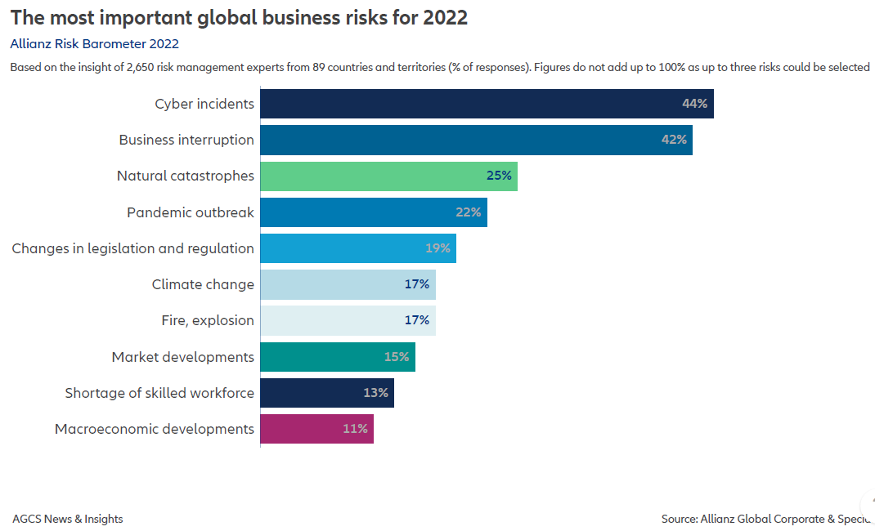
What are Risk Manager’s Concerns?

Slide 34
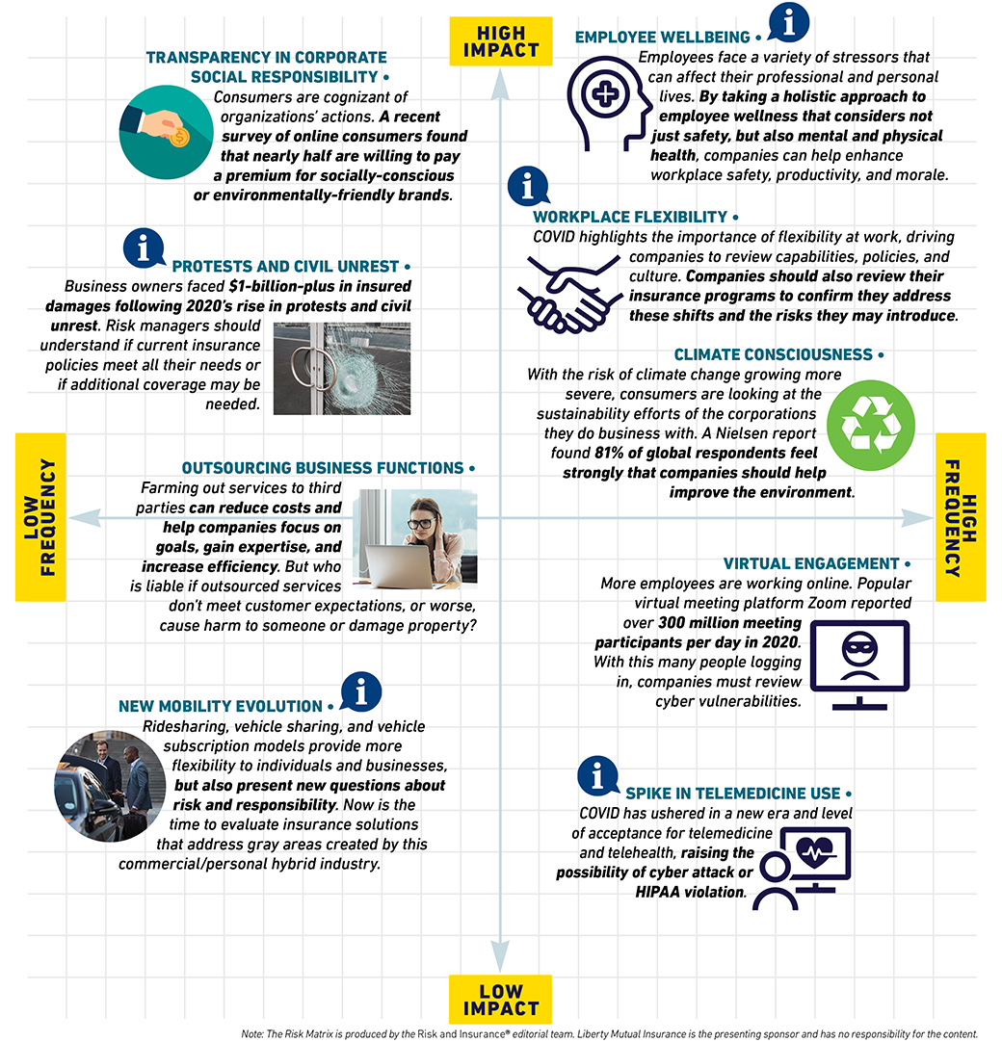
Societal Views Affect Businesses and
Bring About New Risk

Slide 35
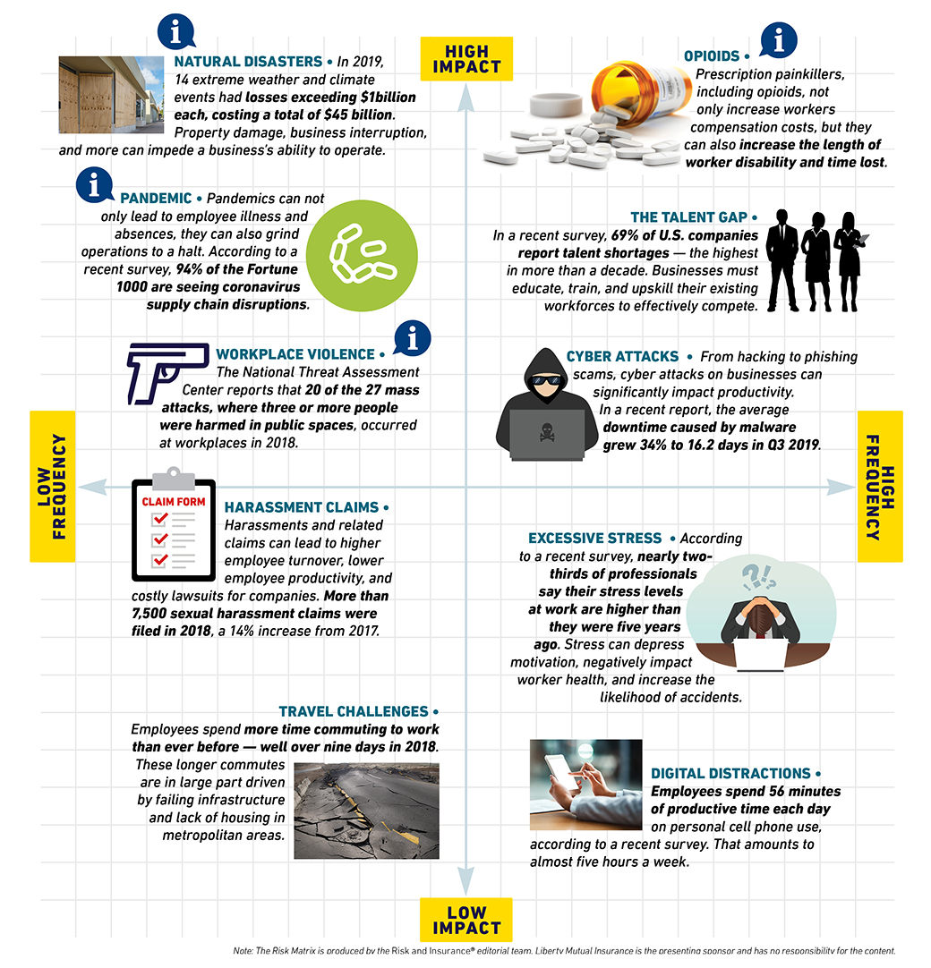
Workplace Interruptions Every Day

Slide 36

Changing Liability Landscape: “Nuclear Outcomes”
Litigation financing/funding is where a third party provides the financial resources to enable costly litigation or arbitration cases to proceed. The litigant obtains all or part of the financing to cover its legal costs from a private commercial litigation funder, who has no direct interest in the proceedings.
“The lawsuit finance industry is largely unsupervised and is not regulated at all at the federal level.”
“Plaintiffs can exponentially increase the potential for favorable outcomes by funding additional surgeries and medical treatments and hiring expensive experts who work to inflate damage models.”
“When medical damages trend upward, the non-economic damages (pain and suffering) follow. The outcome is that higher indemnity dollars are required to dispose of the case, whether by settlement or by verdict.”

Slide 37
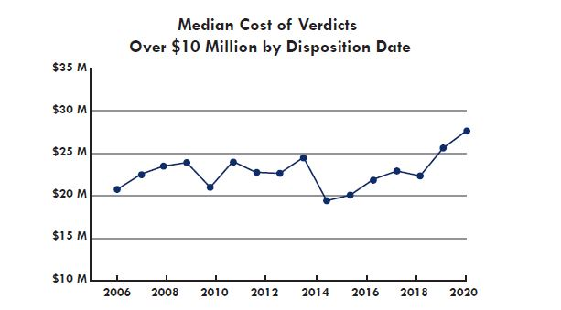
Social Inflation, a continued trend
From 2015 to 2020, the median cost of a jury award over $10 million increased by 35%, from $20 million to $27 million, according to Advisen’s loss database.

Slide 38
Median Cost of Single Fatality

Slide 39
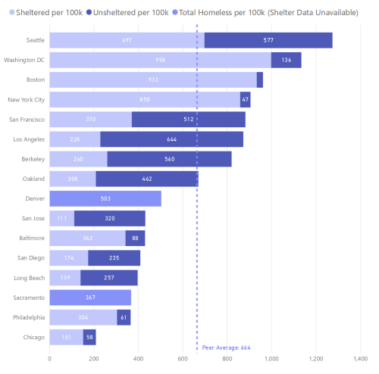
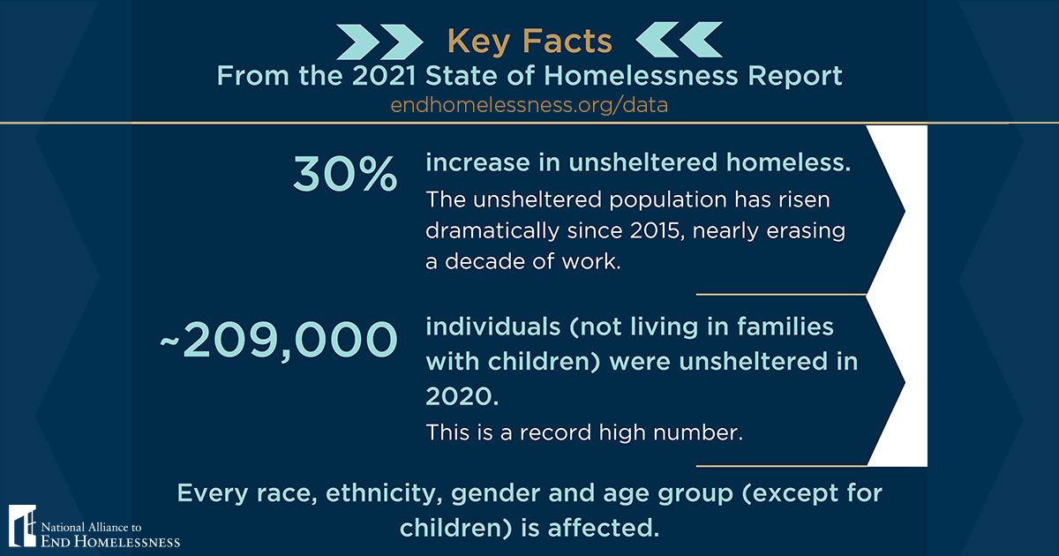
Homelessness in America
Source: Right: endhomelessness.org Left: sfgov.org

Slide 40
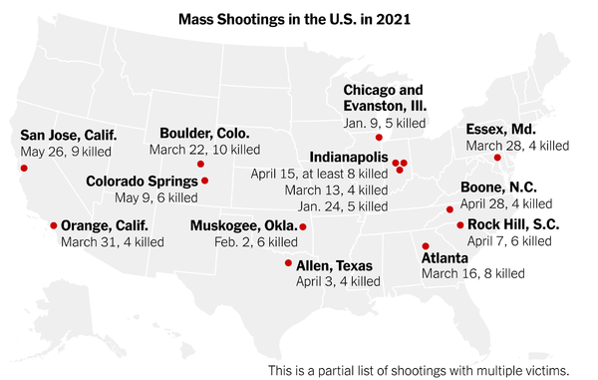
Mass Shootings
New York Times

Slide 41

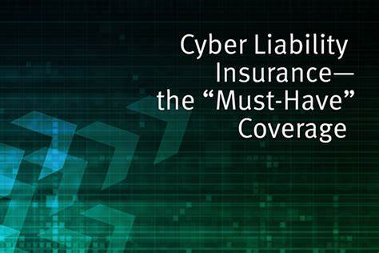
Cyber Facts
Cyber ranks as the top business concern
Of 1,200 business leaders who participated in a national survey, 59% said they worry some or a great deal about cyber, compared to medical cost inflation (53%) and increasing employee benefit costs (53%).
The results mark a return to the top spot for cyber, which also ranked first in 2019.

Slide 42
Multi-Factor Authentication & Phishing
Multi-Factor Authentication (MFA) adds another layer of protection, in addition to your passwords. It requires that a user provides multiple credentials (factors) to validate his or her identity.
MFA is now commonly a minimum requirement for cyber insurance from most carriers. MFA for remote networks reduces the potential for a network security breach caused by a cracked, lost, or stolen password. MFA for email reduces the potential for access and control of corporate email accounts.
Phishing is an attempt to trick you into providing personal or financial information by pretending to be from a legitimate entity or person.
Usually through emails disguised as legitimate communication from reputable sources (i.e. an employee of your own company).
More than $3 billion has been lost to targeted spear phishing over the past 3 years.

Slide 43
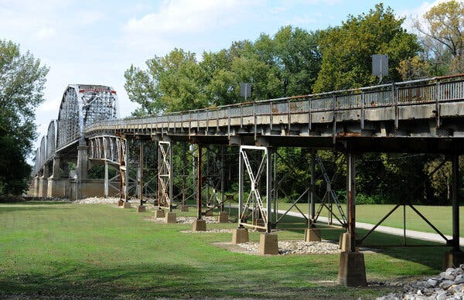
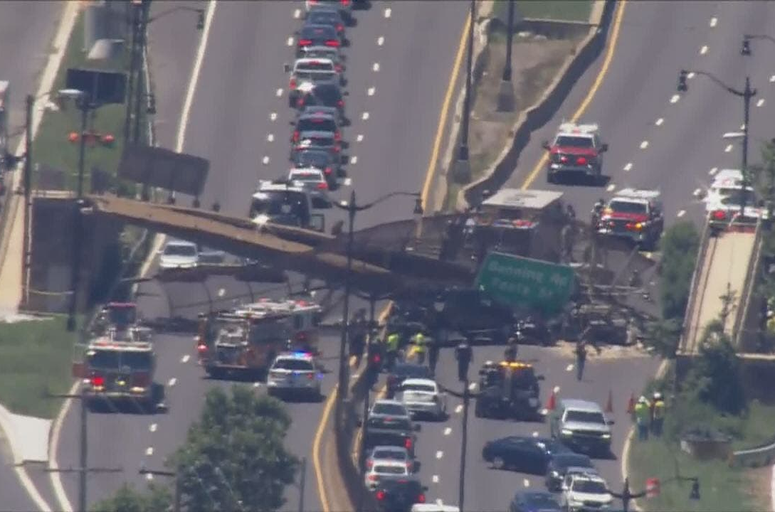
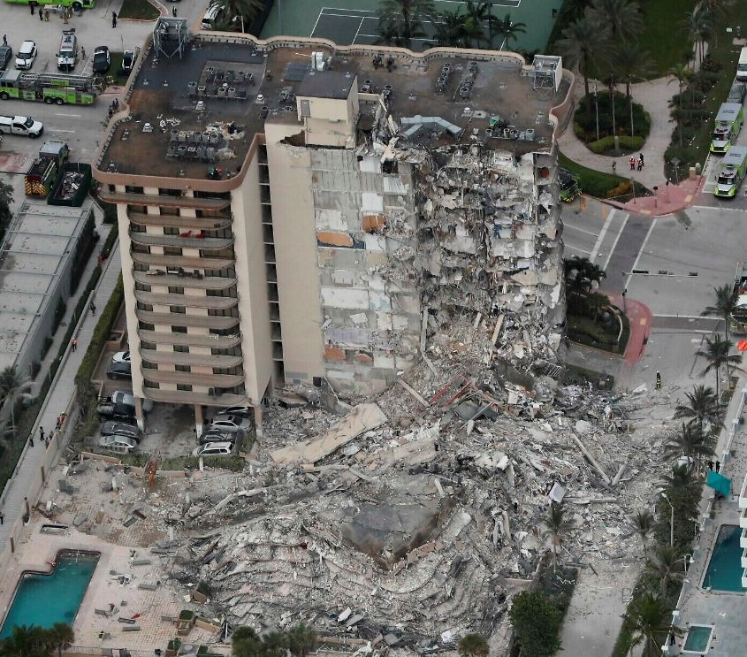
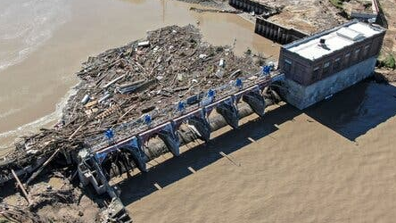
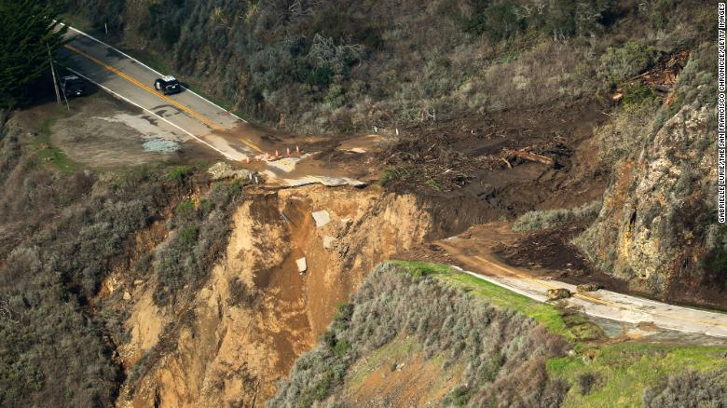
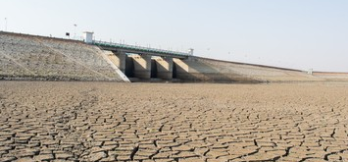
Aging Infrastructure - 2021

Slide 44
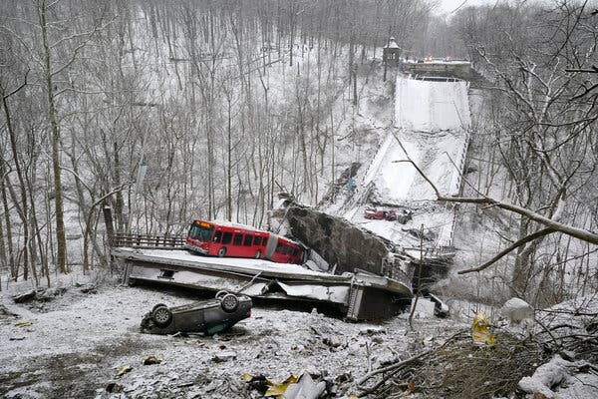
Aging Infrastructure – 2022
Pittsburgh Bridge Collapses Hours Before Biden Infrastructure Visit

Slide 45
Take Aways
Challenges and uncertainties resulting from the ongoing COVID-19 pandemic response.
Is your entity prepared for further financial insecurity?
Cyber Security: “Not if, but When” your entity will suffer a data breach. Are you prepared?
Aging infrastructure… Who’s footing the bill?

Slide 46

Toward the Future
46

Slide 47
Liability Renewal Outlook
Excess liability market:
  Severity trends continue, which gives reason to expect continued hard market conditions with carriers providing lower limit options.
  Higher excess layers seeking disproportionately high percentage increases.
  The market has hardened considerably for the past three renewal cycles, and at current premium levels the path forward is unclear and likely account specific (losses).
Specific problem areas:
  Aggregate limits – pools should consider impact to shared risk layers with reinsurance
  Attachment point
  Overall capacity issues when trying to build a large limit program
Underwriting focus:
  Law Enforcement
  Sexual Abuse & Molestation
  Wildfire Liability

Slide 48
Property Renewal Outlook
Continued scrutiny of client data (SOV, loss runs, COPE, etc.)
  Building materials
  Date of construction / building codes
  Environment
Values Reporting and Trending
  Higher than average trend factors
  Labor shortages, material costs, supply chain interruption
Increased retentions and caps on certain types of exposure
  Wildfire
  Silent Cyber
Market Stabilizing
  Rates continue to be moderating, dependent on loss experience; along with the accepted values trending

Slide 49
Cyber Renewal Outlook
Continued Rate Pressure on Cyber placements
  Premium increases vary by industry segment.
Push for increased retentions
Expect sub-limits, particularly for ransomware losses
Underwriting scrutiny on network security
  Minimum standards.
Many carriers will no longer write public entities or pools

Slide 50

Parting Thoughts
The past 18 months have been a wild ride… looking forward
Overall the insurance market is in a strong financial position.
California risks face challenges for Liability and Property, and there will be pressure on rates to increase.
Loss leaders will continue to see significant increases and the marketplace for coverage will continue to retract.
Insurance coverage for Sexual Abuse and Molestation will continue to face pricing and coverage pressures.
Police Reforms and Qualified Immunity will have ramifications on the insurance market.
Workers’ Compensation remains relatively stable.

Slide 51
Thank you!
Questions?
Please contact us if you would like a copy of this presentation.
January 2022
Contacts for Questions:
Your Email Address

